Slide 1

Year 2
Wednesday 9th September, 2026
2PJ
Mrs Jones
Mrs Berry
Miss Wakefield
2MS
Mrs Stock
Mrs Voyzey
Mrs Roberts
PPA: Mrs Hudson
Mrs Collison

Slide 2

Curriculum
English – reading, writing, phonics, SPaG (Grammarsaurus) Handwriting
Maths – maths, Mastery at Number, times tables challenges
Science
Geography
History
Computing
PE- Monday (outdoors) and Thursday (indoors)
Art
Music- HMS (Thursday morning)
DT
RE
PDL – including No Outsiders
ILT - Independent Learning Time

Slide 3
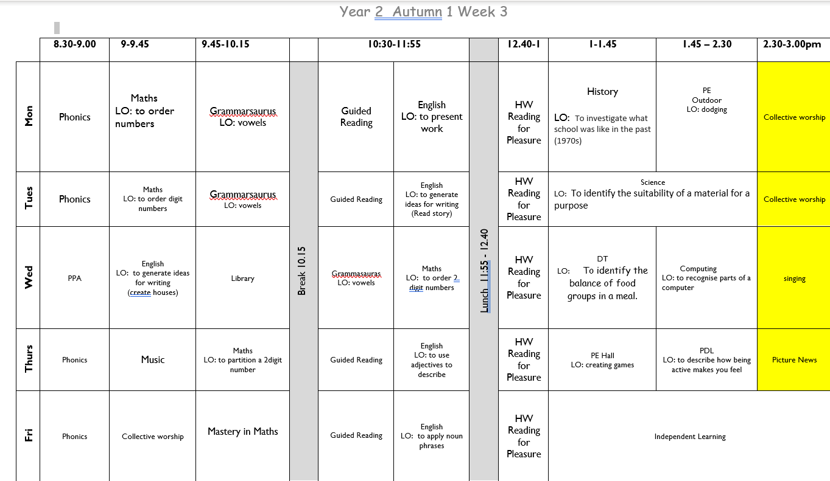
A ‘normal’ week in Year 2…

Slide 4

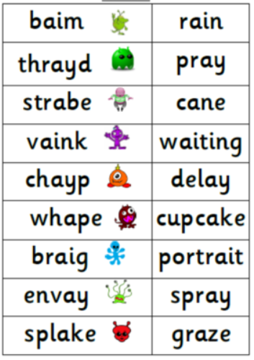
Phonic check
If your child did not pass their phonic check in Year 1 they will re take the check in June.

Slide 5
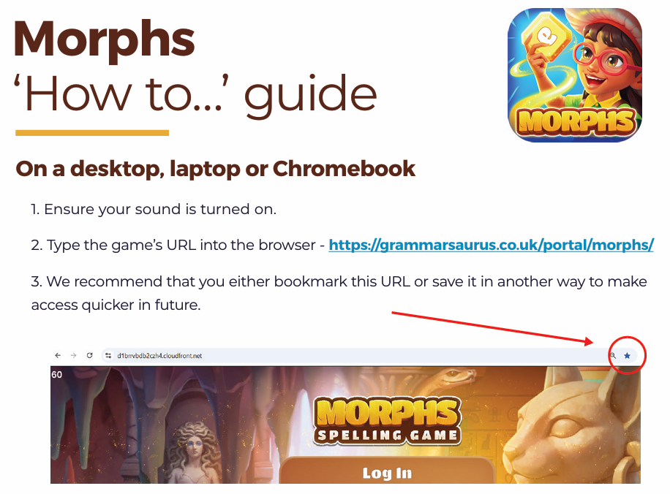
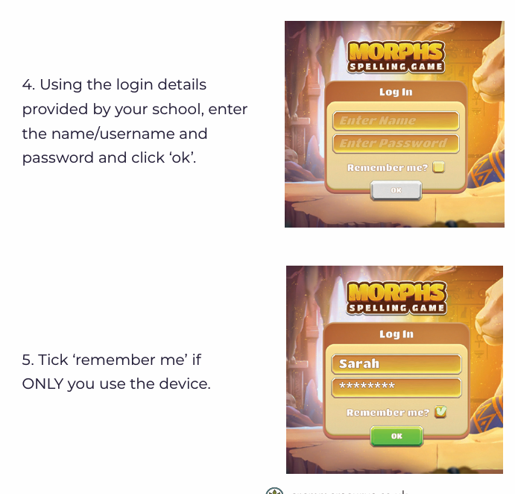
Grammarsaurus
A ‘how to guide’ will be provided and your child’s log in will be attached for your child to practise at home.

Slide 6
Reading
We really want to promote Reading for Pleasure and hope the children develop a love of reading.
Home reading should happen 5 times over the week. Repeated reads are encouraged. Children will also bring home their library books. Please record when your child reads in their diary. For each 25 reads, your child will receive a certificate and their photo will be displayed on our reading celebration wall. Once they reach 100, 200 or 300 reads, they will also receive a prize. If your child reads more than once a day, this will only count as one read for our reading challenge.
Little Wandle books will be sent home on a Thursday and returned to school Monday
Children should be able to read these books easily at home as they develop their fluency. They will also bring home a ‘Love to Read’ book to enjoy with you. These can can be changed throughout the week
Children that have been assessed as secure in phonics will move to colour banded books. Small group reading and phonics interventions will take place for children who are still securing their phonics,
In school
Children who are not secure in phonics and reading will take part in small group intervention as part of the Little Wandle Programme.
Children who are secure will take part in Guided Reading Groups.

Slide 7


Through our Personal Development Learning (PDL) the children will learning about how to keep healthy, how to keep safe, relationships with others, British Values and equality.

Slide 8
Year 2 Trips
Summer 1 - Trip to Weald and Downland Living Museum
(Links to History – Great Fire of London)
Summer 2 – Stokes Bay
(Local environment study)

Slide 9
Other information
Water bottles- bring their own each morning.
Home learning- TT rockstars, Grammarsaurus and a half termly project
School uniform- named please!
PE kits- coloured shirt and PE bottoms to be worn to school EVERY Monday (outdoors) and Thursday (indoors).
Please ensure your child has shoes they can fasten INDEPENDENTLY.
School Grid
Please check the school website for any other school updates.
St John's, Gosport Church of England Voluntary Aided Primary School - Home

