Slide 1
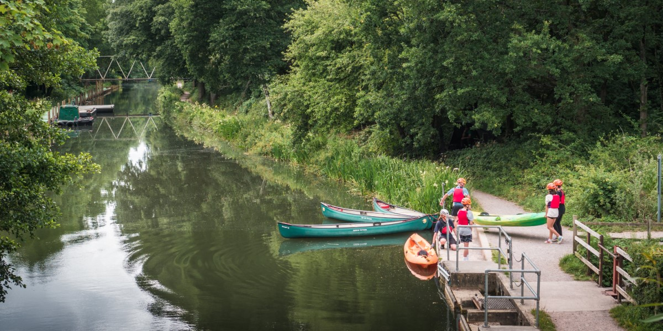
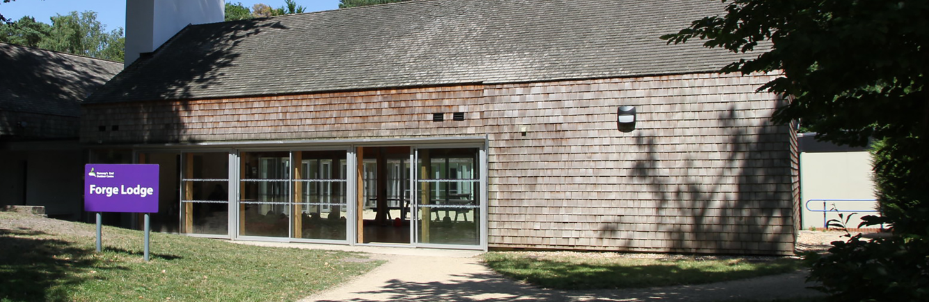
Runways End 2026

Slide 2
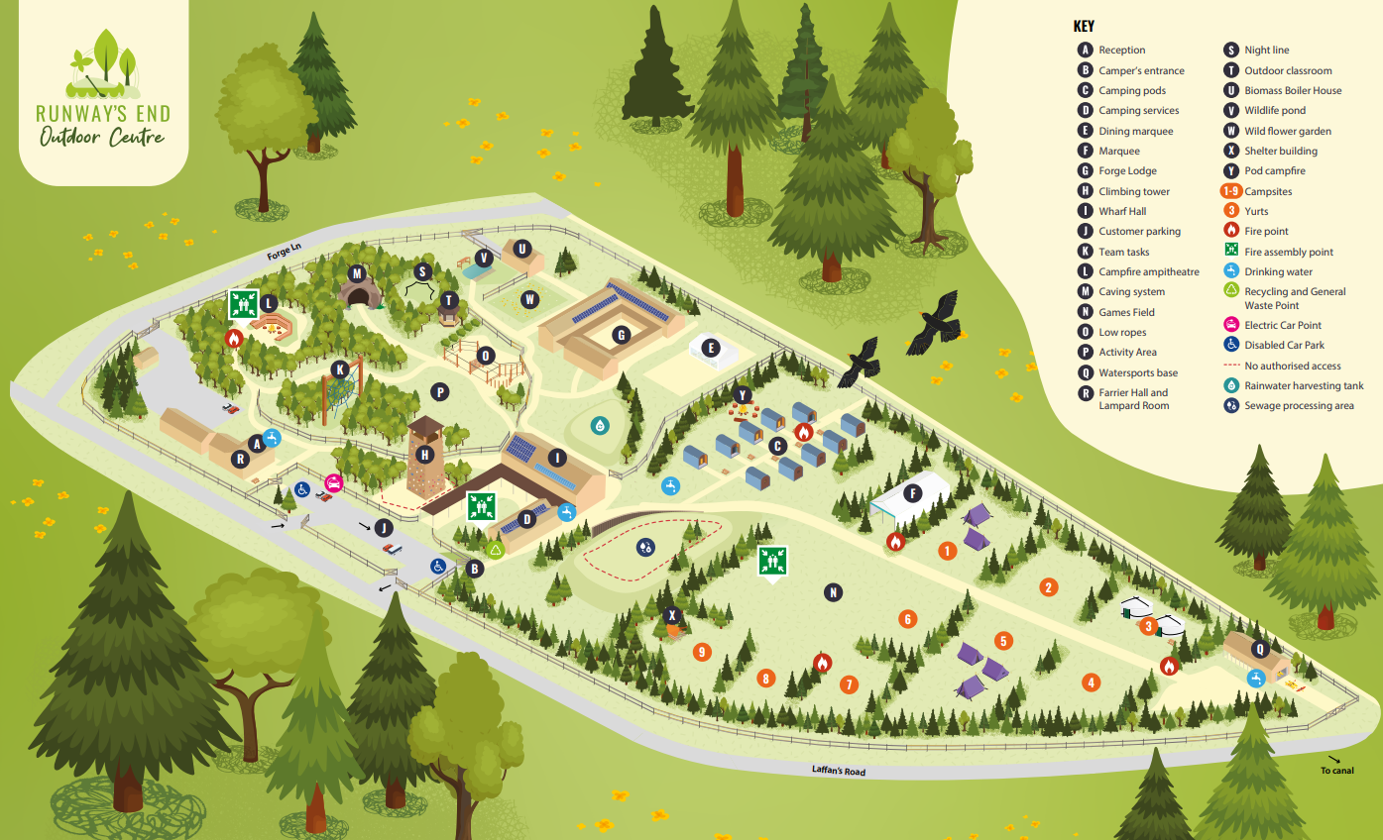

Slide 3



Some of the activities we will be doing:
The children will be split into 4 groups. The activities are being run by the trained instructors. Each group will be overseen by a member of St Johns staff.

Slide 4
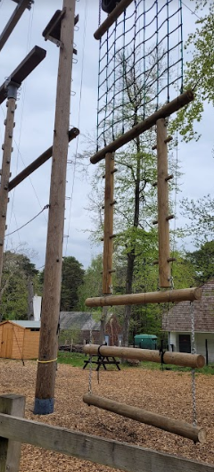
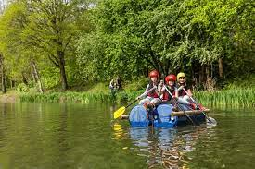
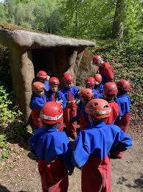

Slide 5
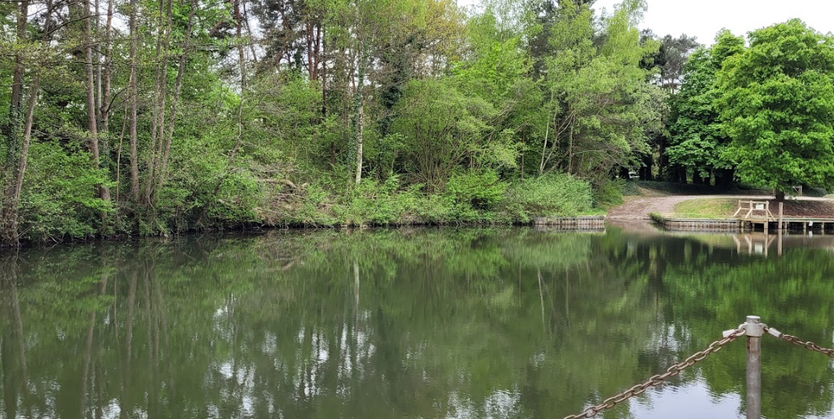
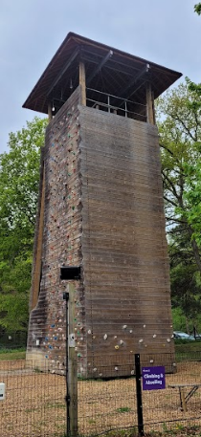


Slide 6
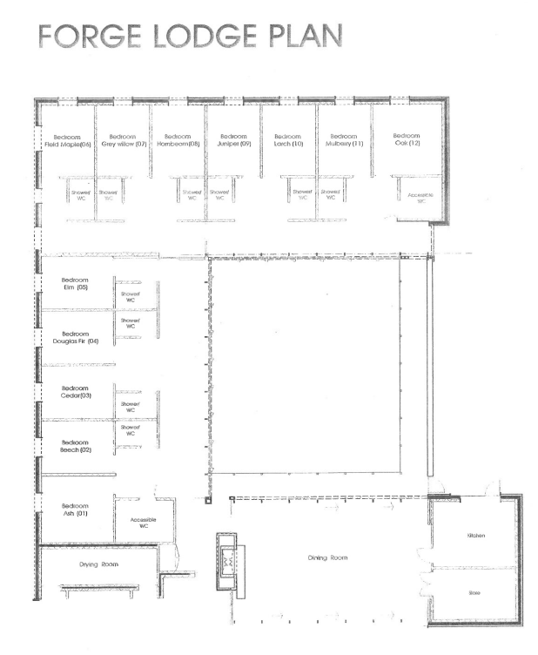
Adults
BOYS
Girls

Slide 7
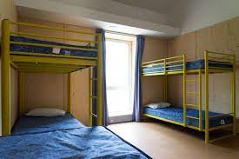
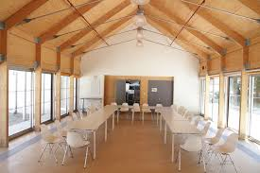
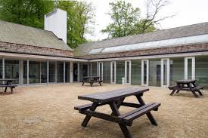

Slide 8
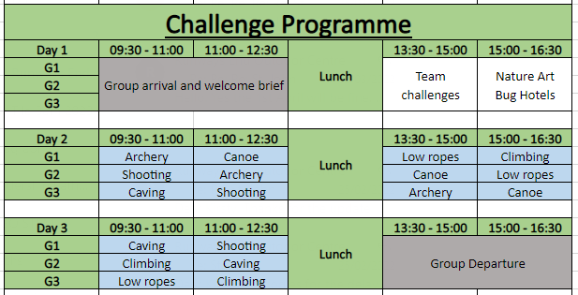
Runways End 2026
Sample 2-night program

Slide 9
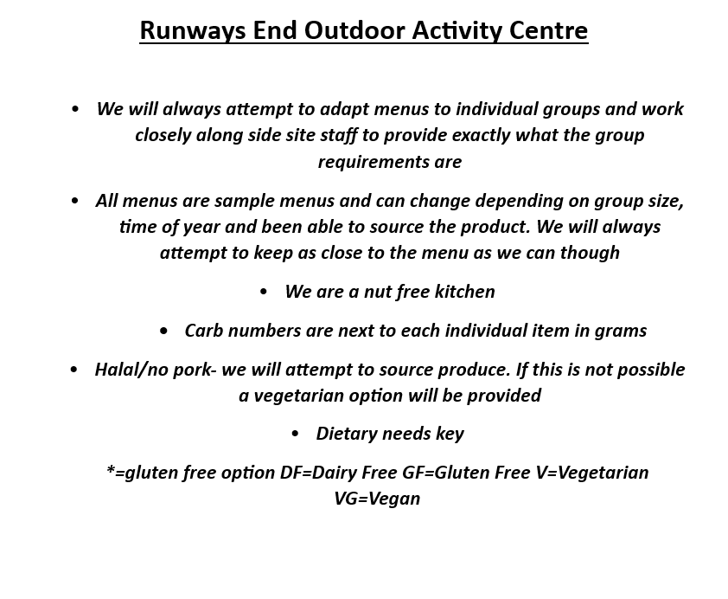

Slide 10
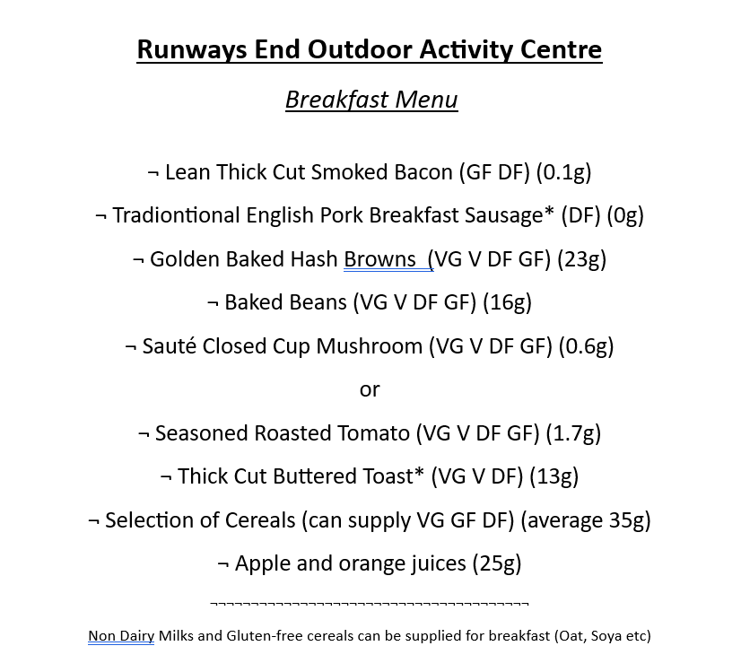

Slide 11


Slide 12


Slide 13
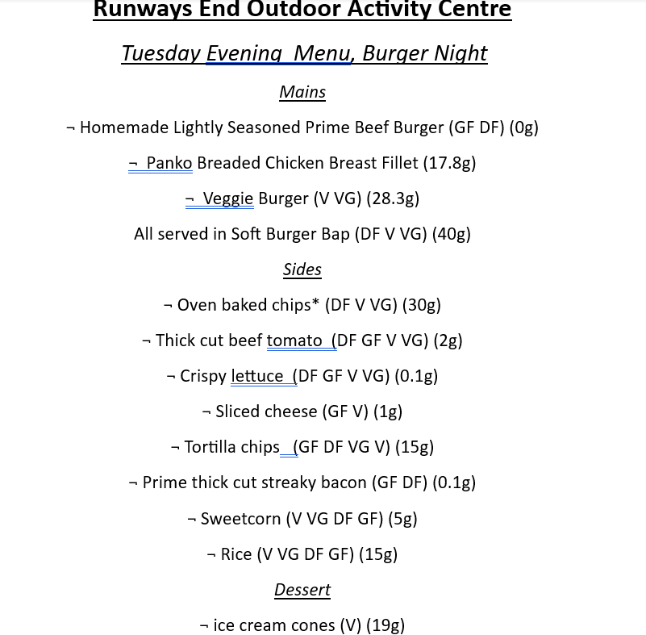

Slide 14


Medicines:
If your child will be taking regular medicines whilst we are away please can you make sure they are in a labelled plastic bag or envelope with instructions on there.
Our first aider will be in charge of all medicines.

Slide 15

Lunch on the first day
Your child will need a packed lunch on the first day. If you are free school meals we will order one for you.

Slide 16
On the day:
9.00am on Monday 9th March 2026, we will spend two nights at Runways End and return to school at approximately 3:30pm on Wednesday 11th March 2026.
The children will be expected in school on Monday 9th March 2026 at normal time with their belongings. The children can come straight into 6LJ via the outside door where we will register them before going.
If we are running late on the return journey due to heavy traffic, we will contact you by text.

Slide 17
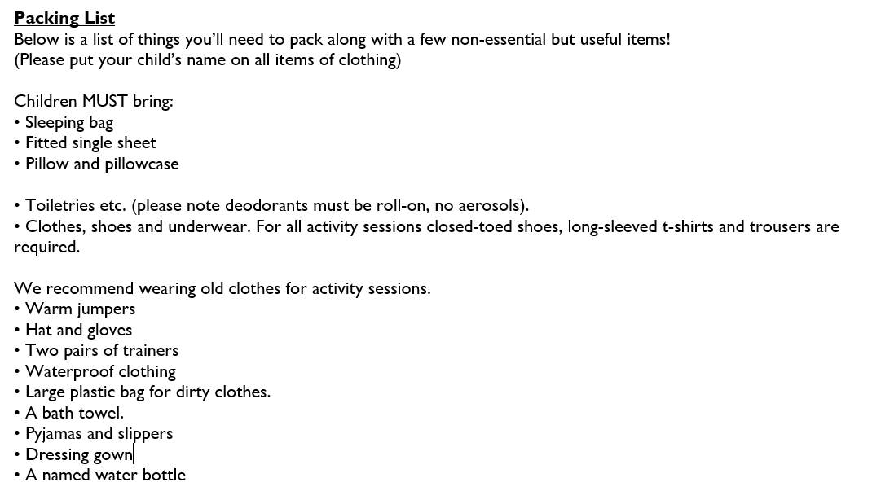

Slide 18
Any questions?

