Slide 1
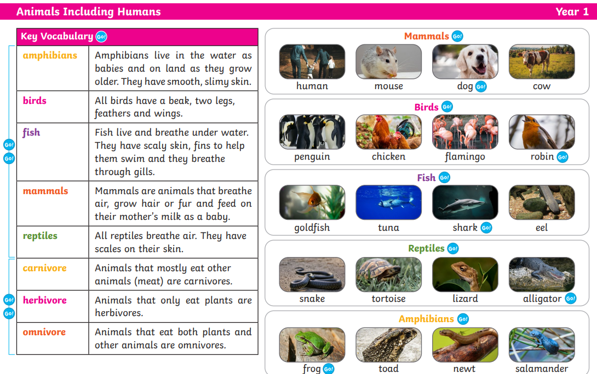
Autumn 2 Science Knowledge Organiser

