Slide 1

Welcome to Year 4
2018-2019
Mr Norris and Miss Hibberd
Mrs White, Mrs Matthews, Miss Chester, Mrs Shaw

Slide 2
Classes and Staff
- 4RH
Teacher : Miss Hibberd
Support staff : Miss Chester, Mrs Shaw
4AN
Teacher : Mr. Norris
Support staff : Mrs White, Mrs Matthews

Slide 3
Curriculum Learning and aims for the year
In Year 4, we believe learning should be varied, fun and engaging. We will ensure that your children have the opportunity to explore new learning through a whole variety of topics.
Topics will include Journey to the Centre of the Earth (Volcanos and Earthquakes), Voyage of Discovery (Charles Darwin), The Magic Greenhouse (plants and monsters), Anglo-Saxons and Vikings, The Iron Man and Electricity.

Slide 4

Behaviour
We have a positive approach to behaviour and high expectations of it. We are using the Six Strands to recognise specific learning behaviours and your child will be rewarded as they show these behaviours
Pause – children are put on pause if they make the wrong choice.
Non-negotiables – are on display in all classes. These are the expectations for all children.
Sometimes a child will need to go to another class to complete work and do a Reflection with an adult during lunch or break times or at the end of the day if they are unable to turn their behaviour around. This is an opportunity to discuss their behaviour in a calm way.

Slide 5

Reading
We will continue to follow our reading challenge expectations; children will earn ticks over the year and catch up reading will take place of Fridays if children have not read at least 5 times in the previous week.
We want to encourage a positive reading attitude so we will discuss the books children are reading with them and aim to listen to children reading during the week in school too.
Our library day is on Friday and this will be an opportunity to change books. Please make sure your children bring in their library books everyday.

Slide 6

Homework
Home work will be set each week
Spelling Shed
TT Rockstars
The children will be shown how to do these in school before we start setting these for homework.
Each half term, a home learning project will also be set that is linked to our topic.
An email will be sent home weekly to inform you of the tasks.

Slide 7
Times Tables
In the Summer Term, the government will be testing Year 4 on their timetables and so we will be having a big focus on multiplication facts.
All the children have a log in for a online training game called Times tables Rockstars. They can use this to practise at home.
Learning times tables is part of the homework in Year 4.

Slide 8
Uniform and PE Kit
The children have come looking very smart in their uniforms. Please remember they are required to wear plain black shoes.
PE days are on a Monday and Tuesday. Children come into school in full PE kit on these days.
Children are allowed to wear jogging bottoms and a jumper when the weather becomes colder.

Slide 9
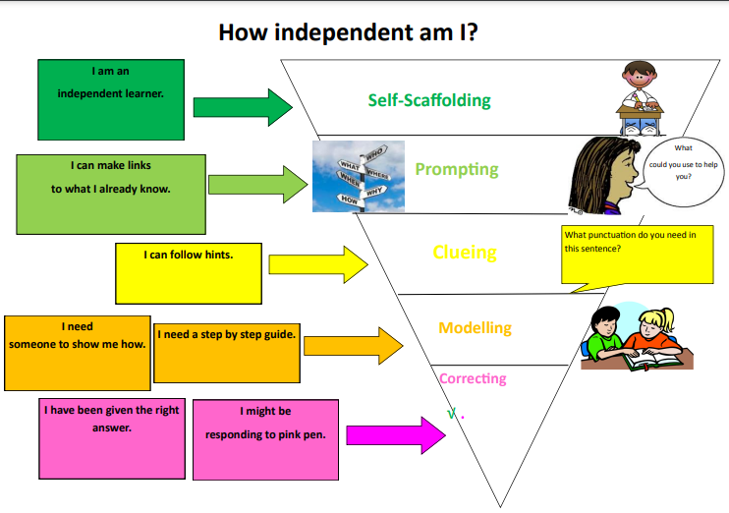
Metacognition and Mita Triangle

Slide 10



At St John’s we teach British values and equality through our personal development lessons.

Slide 11

Two of the ways we teach about equality is through the use of books and also a half-termly collective worship where we focus on something from the media that highlights inequality and ‘ No Outsiders’ .

Slide 12
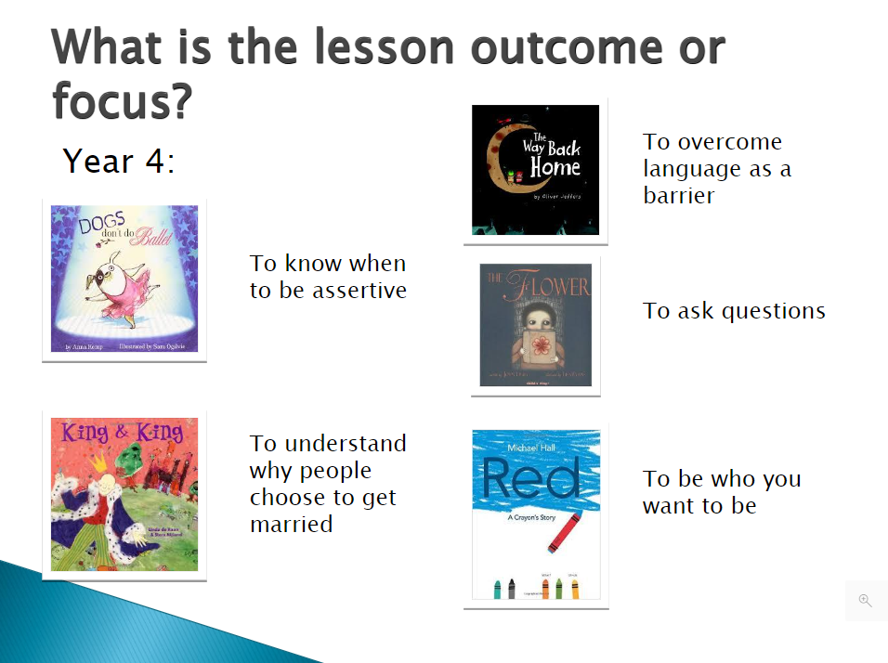

Slide 13

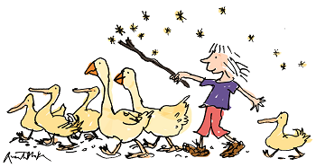
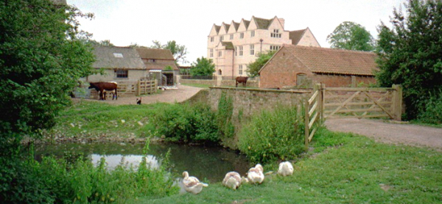
Wick Court
Monday 17th November – Friday 21st November 2025

Slide 14
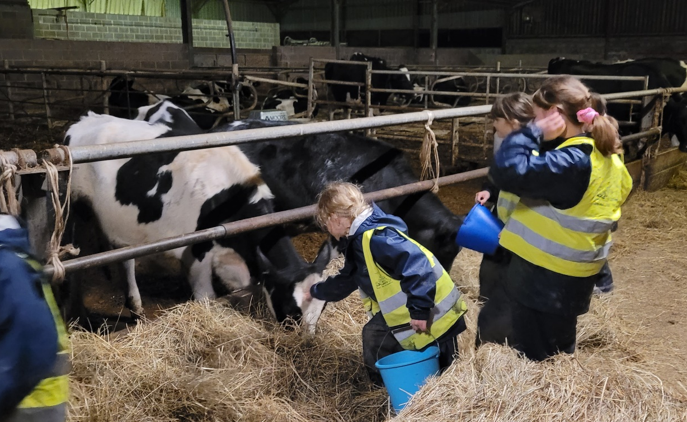
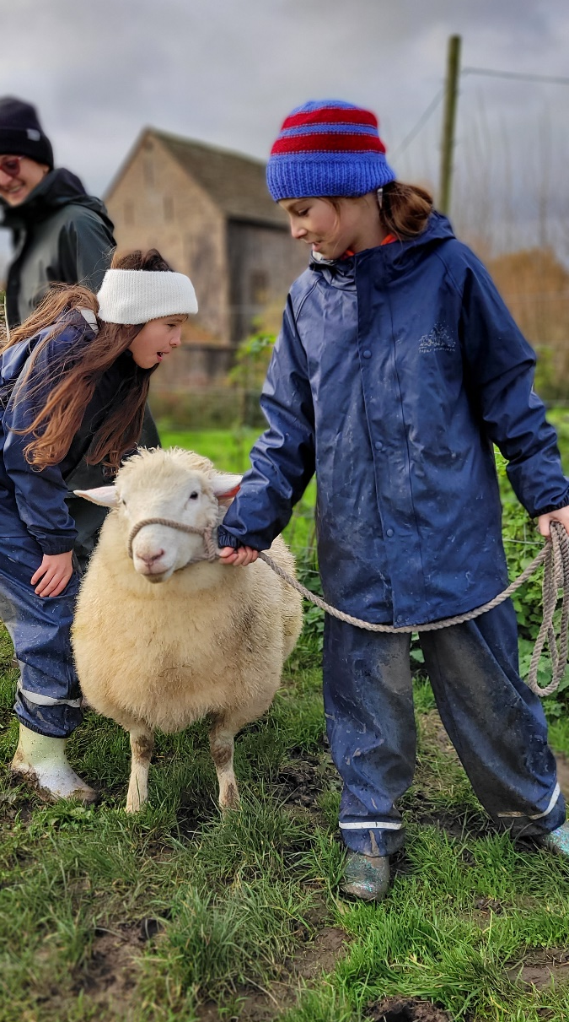
Wick Court 2023

Slide 15
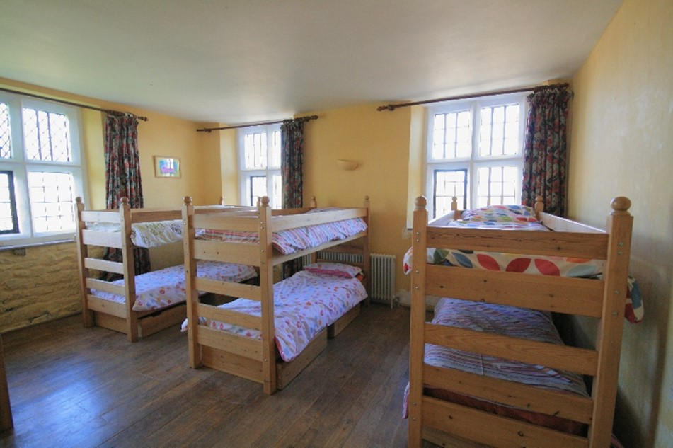
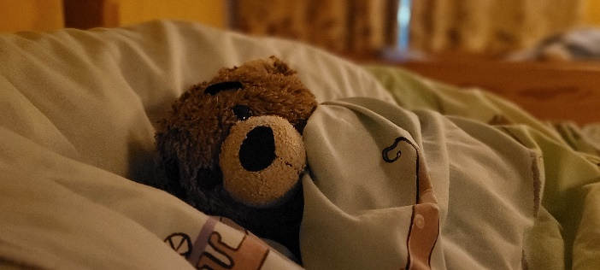
What is it?
We have exclusive use of the farm.
The children will stay in dormitories in the farmhouse.
Dormitories sleep between
4 and 12 children and will have
en-suite or adjacent bathrooms.

Slide 16
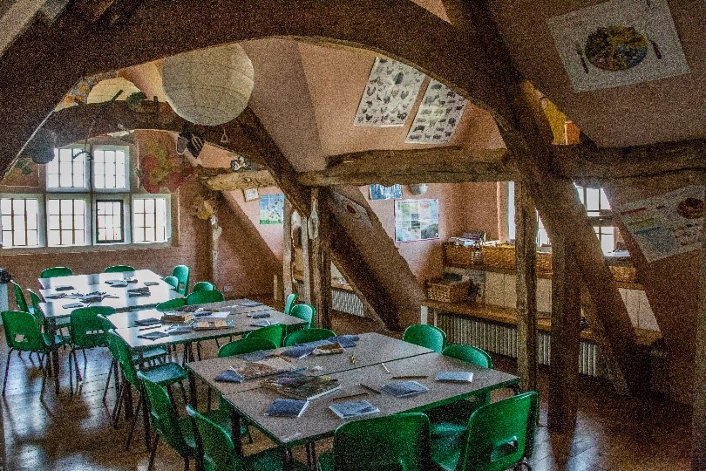
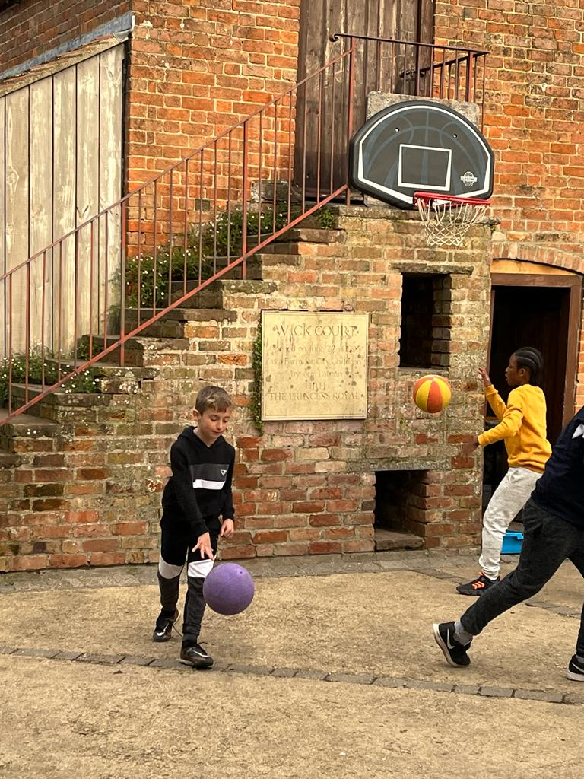
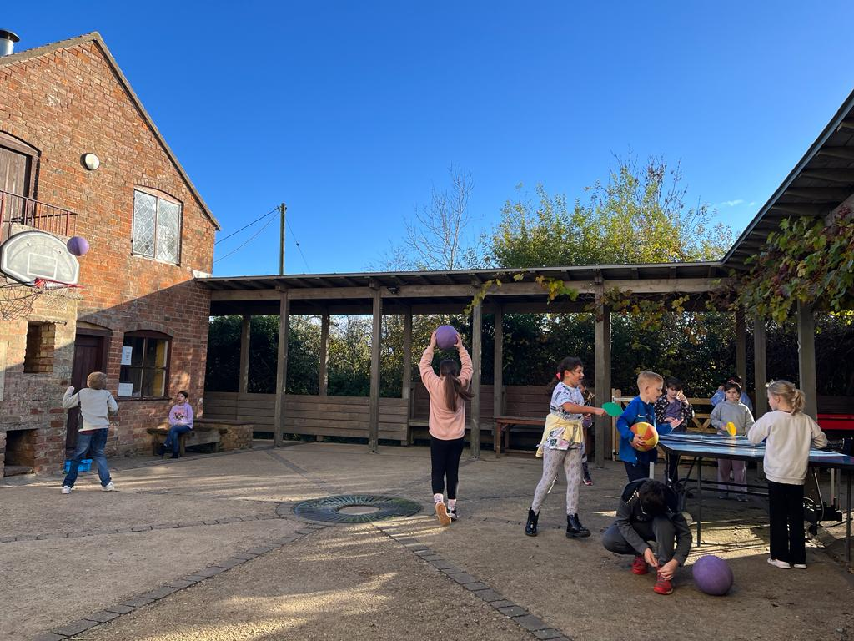
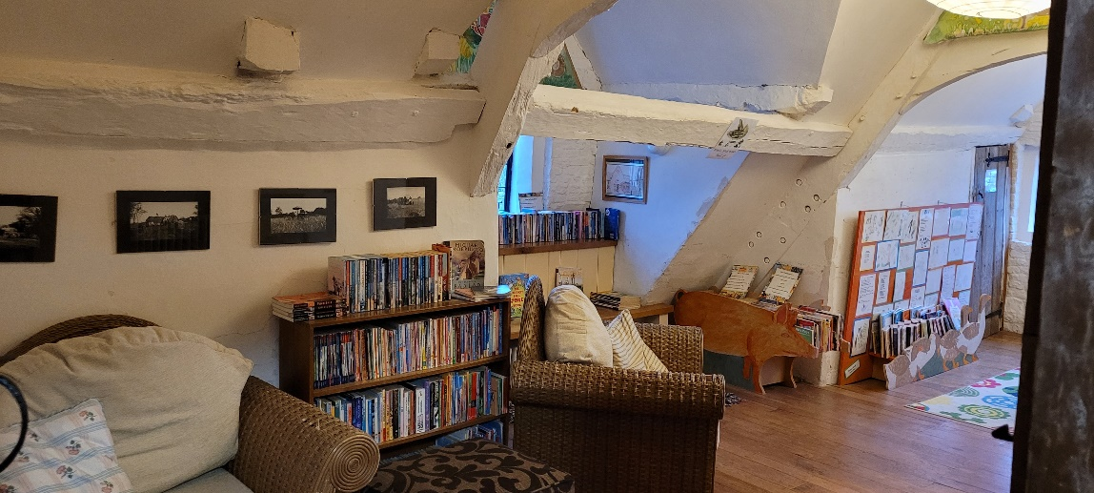

Slide 17
What is it?
The children will engage in farm activities such as:​ collecting eggs, grooming horses, feeding different farm animals, herding sheep, working in the kitchen garden, cooking meals using fresh farm produce and picking apples.
Each core session will be repeated over the week so that it allows the children to overcome fears and master new skills.
They will also enjoy Forest School activities like den building and fire lighting.
There will be time each day for the teachers to lead their own curriculum led activities.

Slide 18
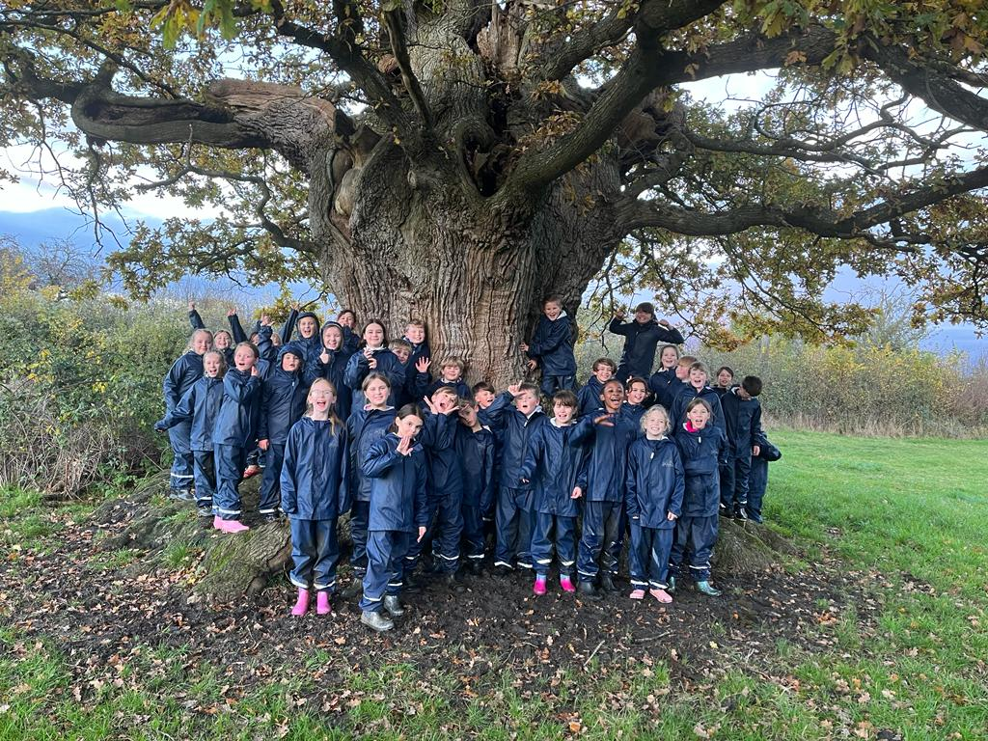
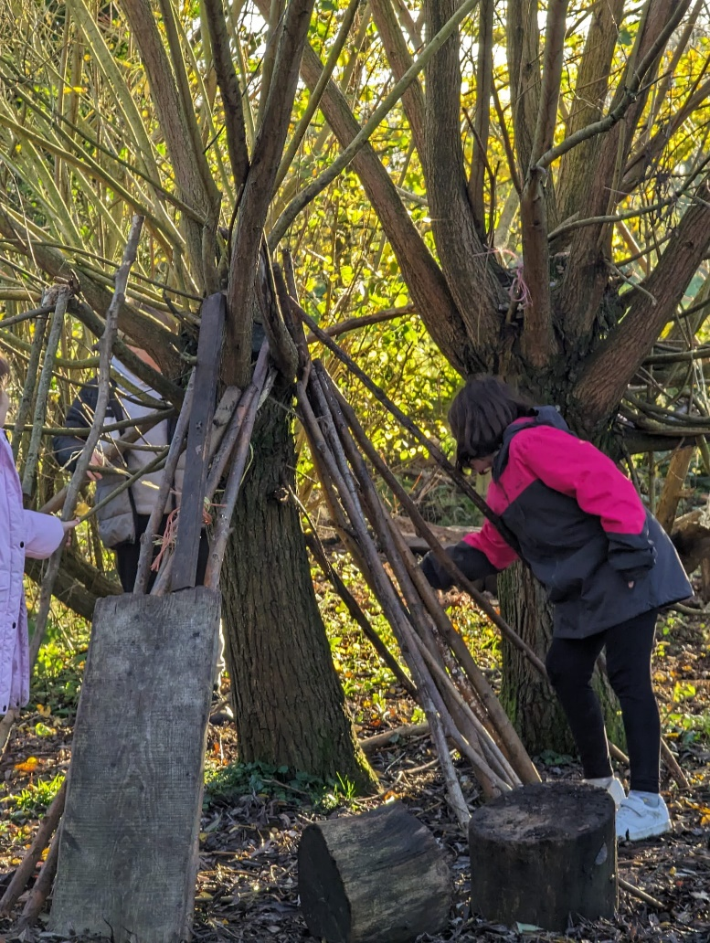

Slide 19
What is it?
Wick Court is a screen free establishment. The children will not be allowed to take mobile phones and there is no TV. This will ensure they have an un-plugged weekend and are able to fully enjoy all there is to offer.
There will be plenty of time for the children to explore the different areas of the house.
It has a living space with sofas and a wood burner.
Also there is a selection of board games, books and a toy farm.
Outside in the court yard, children can play basketball, table tennis and some giant games.

Slide 20
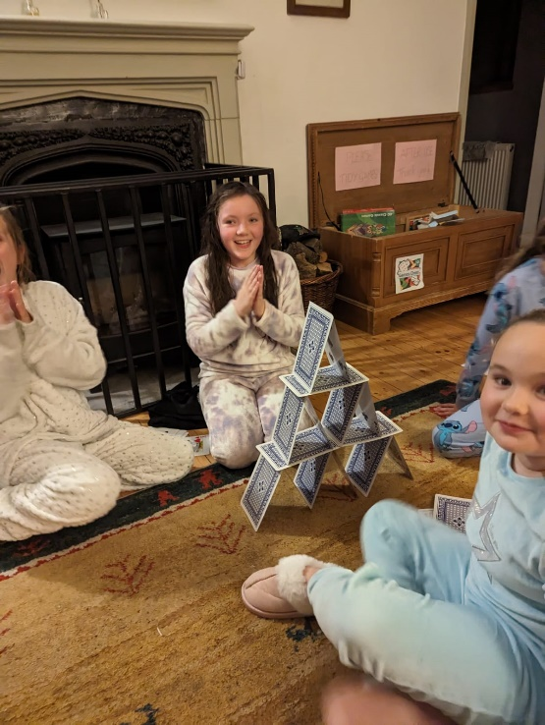
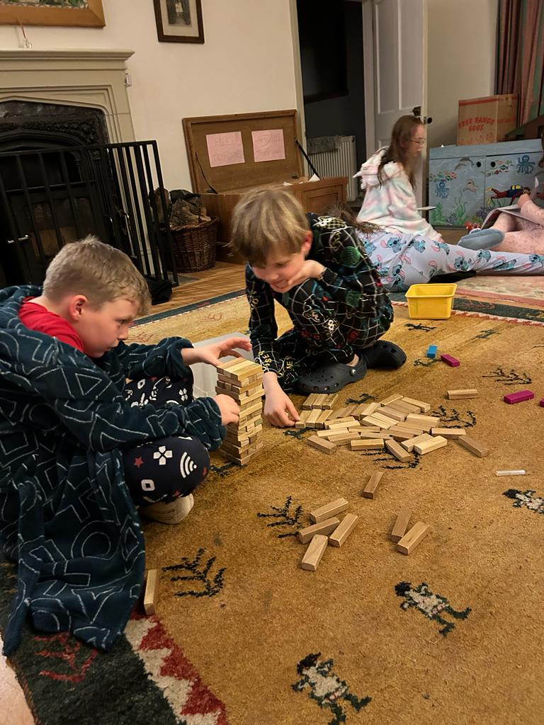
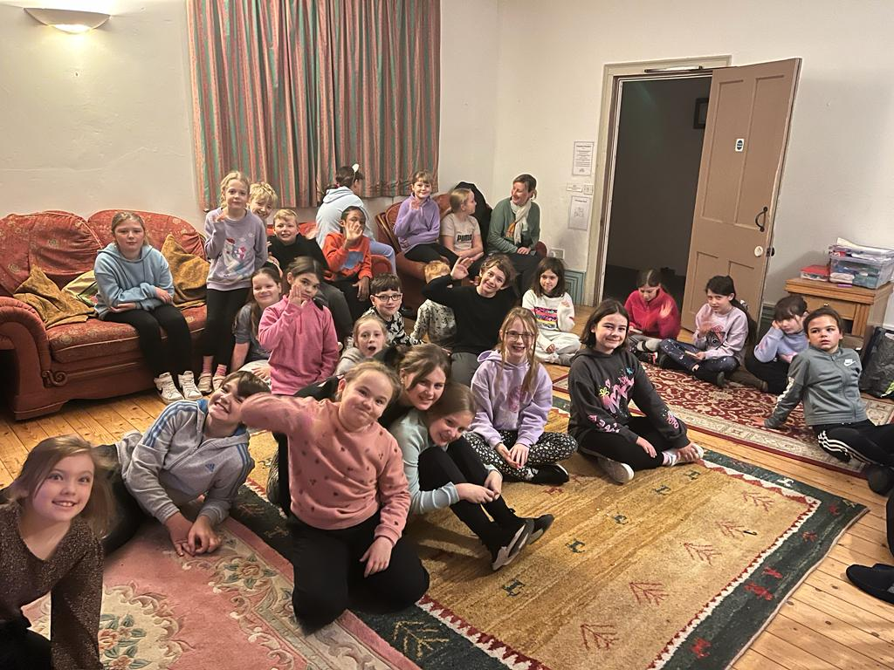

Slide 21
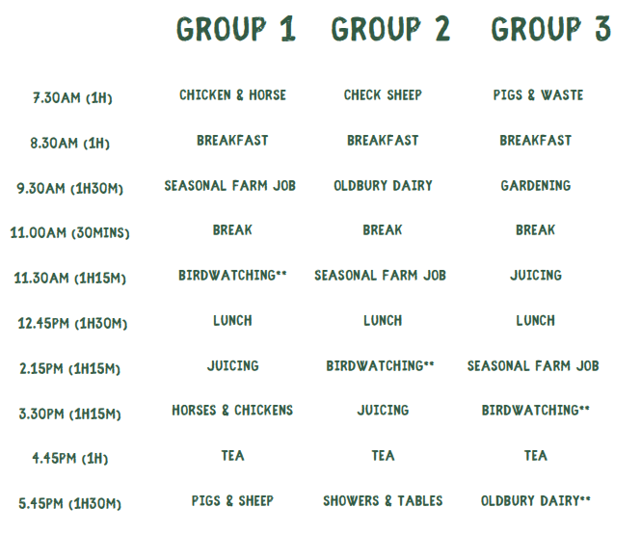
Sample daily program

Slide 22
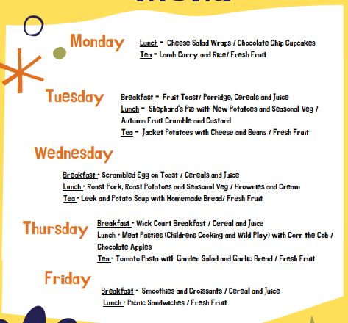
Sample menu

Slide 23

Any questions?
If you have any specific concerns about your child, please make an appointment to see the teacher or feel free to email us at
year4@st-johns-gosport.hants.sch.uk

