Slide 1

Welcome to Year 3
2018-2019
3SS Mrs. Schneider 3SJ Mrs. Jones
Miss. Pankhurst & Mrs. Voyzey Miss. Smith & Mrs. Shaw

Slide 2
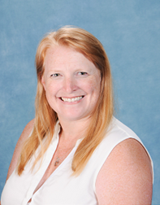
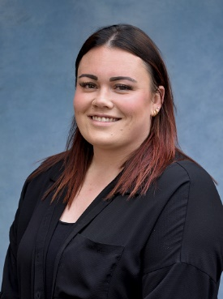
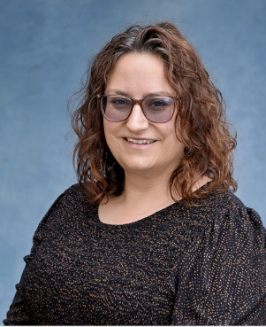
Classes and Staff
3SS
Teacher: Mrs. Schneider
Support Staff: Miss. Pankhurst and Mrs. Voyzey

Slide 3
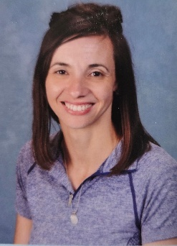
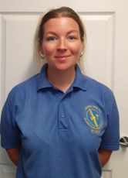
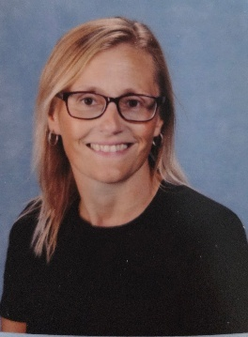
Classes and Staff
3SJ
Teacher: Mrs. Jones
Support Staff: Miss. Smith and Mrs. Shaw

Slide 4
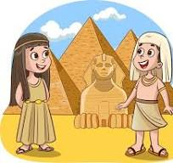
Curriculum Learning and aims for the year
In Year 3, we believe learning should be varied, fun and engaging. We will ensure that your children have the opportunity to explore new learning through a whole variety of topics.
Topics will include: The Stone Age, The Ancient
Egyptians & The Ancient Romans
              Settlements, Rivers & Antarctica
              Egyptian Collars, Castles & Pizzas
              Potion Making, Tomb Raiders, Plastic Pollution to name just a few!

Slide 5

Behaviour
We have a positive approach to behaviour and high expectations of it.
The learning recognition board lets children achieve targets from our six strands. This allows the children to see they are making the right choices in their learning.
Pause – children are put on pause if they make the wrong choice.
Sometimes a child will need to go to another class to complete work and/or do a Reflection with an adult during lunch or break times, or at the end of the day, if they are unable to turn their behaviour around. This is an opportunity to discuss their behaviour in a calm way.
We will send texts home or speak directly to you about good behaviour or to inform you about Reflections

Slide 6

Reading
We will continue to follow our reading challenge expectations; children will earn certificates over the year by reading at home.
Our library day is on Wednesday and this will be an opportunity to change books. Please make sure your children bring in their library books everyday.
Your child will have a Love To Read class book or a Little Wandle book they can bring home and their library book.
Little Wandle is our phonic program and it is important that these books are read at home and come back into school everyday.

Slide 7

Homework
Home work will be set every Friday and it is the expectation that it is completed by the following Monday:
Daily Reading
Spellings – tested every Friday
TT Rockstars (times table practise)
Half termly project linked with topic. This will start next term with the Stone Age

Slide 8



At St John’s we teach British Values and equality through our Personal Development lessons.

Slide 9

Two of the ways we teach about equality is through the use of books and also a half-termly collective worship where we focus on something from the media that highlights inequality and ‘ No Outsiders’.

Slide 10


Slide 11

Uniform and PE Kit
The children have come looking very smart in their uniforms. Please remember they are required to wear plain black shoes.
PE days are on a Thursday (inside) and Friday (outside). Children come into school in full PE kit on these days.
Children are allowed to wear jogging bottoms and a school jumper when the weather becomes colder.

Slide 12

Trips
Approximate Prices
Autumn term: Visit from an artist – Free
History Box for the Stone Age - Free
Spring Term: Trip to Search for Science – Skeletons & Muscles - £8
Portals to the Past for Ancient Egypt Day - £11
Elson Library - Free
Summer Term: Alver Valley River - Coach costs TBC
History Box for the Romans – Free
Day Visit to Stubbington Study Centre - £13.50
Gosport Giant Sing - Free

Slide 13

Other Information
Please discourage your children from bringing in things from home unless it has been specifically requested.
As the weather gets wetter and colder, please make sure they have a named coat with a hood.
Snacks should be a healthy breakfast bar or fruit – no nuts, chocolate etc

Slide 14

Any questions?
If you have any specific concerns about your child, please make an appointment to see the teacher or feel free to email us at
adminoffice@st-johns-gosport.hants.sch.uk

