Slide 1

Year 2
2025
2PJ
Mrs Jones
Mrs Roberts
Miss Wakefield
2MS
Mrs Stock
Miss Dean
Wednesday 10th September, 2025
PPA: Mrs Wray Mrs Hudson

Slide 2

Curriculum
English – reading, writing, phonics, SPaG, Handwriting
Maths – times tables, Maths Whizz, Mastery at Number
Science
Geography
History
Computing
PE- Monday (indoor) and Thursday (outdoor)
Art
Music- HMS (Monday afternoon)
DT
RE
PDL – Jigsaw and No Outsiders
ILT - Independent Learning Time

Slide 3
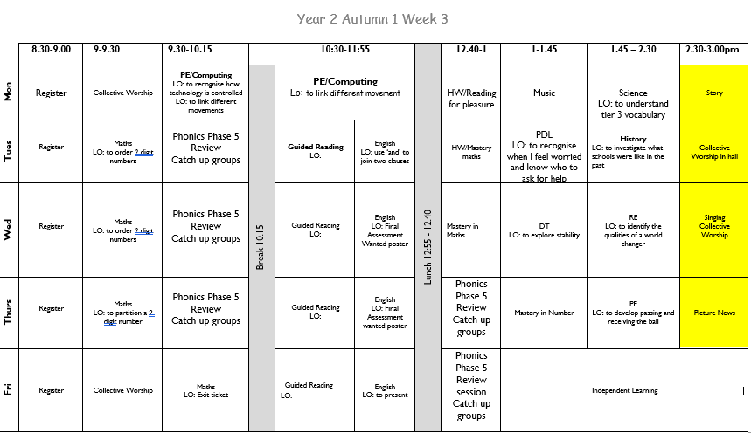
A ‘normal’ week in Year 2…

Slide 4

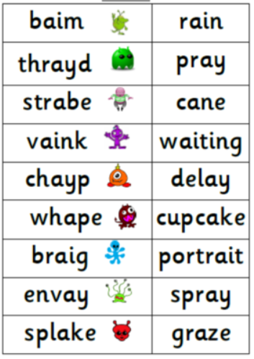
Phonic check
If your child did not pass their phonic check in Year 1 they will re take the check in June.

Slide 5
Reading
We really want to promote Reading for Pleasure and hope the children develop a love of reading.
Home reading should happen 5 times over the week. Colour banded books can be changed throughout the week. Repeated reads are encouraged. Children will also bring home their library books.
Little Wandle books will be sent home on a Thursday and returned to school Monday
Children should be able to read these books easily at home as they develop their fluency. They will also bring home a ‘Love to Read’ book to enjoy with you.
Children that have been assessed as secure in phonics will move to colour banded books. Small group reading and phonics for children who are still securing their phonics,
In school
Children who are not secure in phonics and reading will take part in small group intervention as part of the Little Wandle Programme.
Children who are secure will take part in Guided Reading Groups.

Slide 6



At St John’s we teach British values and equality through our personal development lessons.

Slide 7
Year 2 Trips
Autumn 2 – Marwell Zoo
(links to Rainforest learning in Geography)
Summer 1 - Trip to Weald and Downland Living Museum
(Links to History – Great Fire of London)
Summer 2 – Stokes Bay
(Local environment study)

Slide 8
Other information
Water bottles- bring your own each morning.
Home learning- TT rockstars, Spelling shed and a half termly project
School uniform- named
PE kits- coloured shirt and PE bottoms to be worn to school EVERY Monday (indoors) and Thursday (outside).
Please ensure your child has shoes they can fasten INDEPENDENTLY.
Please check the school website for any other school updates.

