Slide 1


Welcome to our phonics and reading information sharing session
Please turn your microphones off
Please turn your cameras off
Please do not record anything on screen.
We will record the session so it is accessible later
Use the chat for any questions

Slide 2
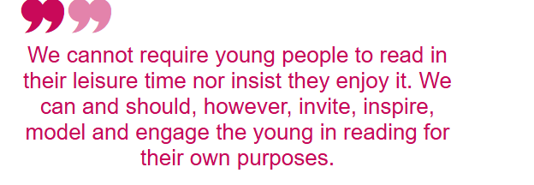
Self-determination theory applied to reading

Slide 3
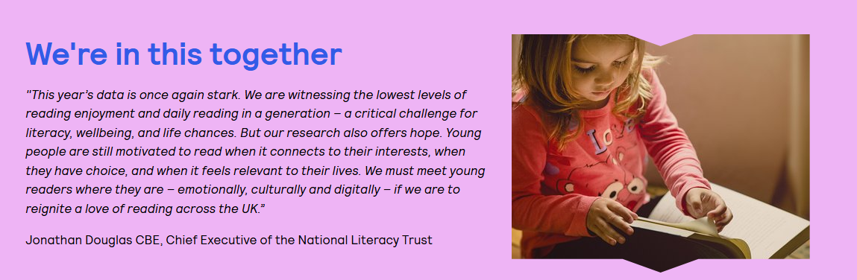

Slide 4
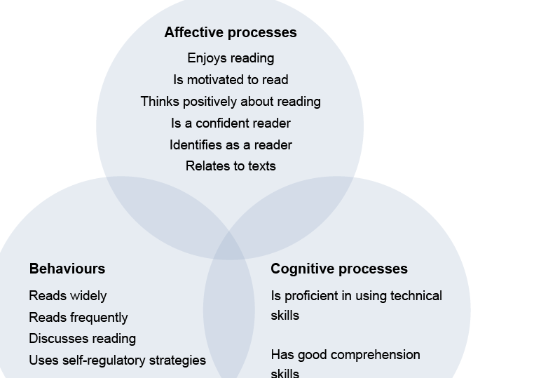
What do we mean by “reading” (Clark and Teravainen, 2017, p2)

Slide 5
Concerns about reading enjoyment
Recent research shows that fewer children are enjoying reading for pleasure than ever before. In fact, less than half of 8–18-year-olds say they enjoy reading, and the number drops as children get older.
Boys and children on free school meals are finding it hardest to keep reading regularly.
We know that reading for fun makes a big difference to learning and confidence, so we want to work together to turn this around.
Even a few minutes of reading at home each day can help your child develop skills and a love of stories that will last a lifetime.
Here are some simple ideas to make reading enjoyable:
Let them choose – comics, magazines, or books they love.
Read together – share a story or take turns reading aloud.
Talk about books – ask what they liked or what might happen next.

Slide 6
What is the life-long impact of not being able to read?
Education and Employment
Reading ability strongly predicts educational attainment in primary, secondary and higher education.
Children who struggle with reading are less likely to complete secondary school and gain qualifications, which limits access to skilled jobs and higher education. [cfey.org]
Adults with very poor literacy skills earn £1,500 less per year on average and around £33,000 less over a lifetime compared to those with basic literacy. They are more likely to be unemployed or stuck in low-paying, insecure jobs.

Slide 7
Health and Wellbeing
Low literacy is linked to poor health outcomes because individuals struggle to understand medical instructions, prescriptions, and health information. This leads to higher rates of chronic conditions (e.g., diabetes, heart disease) and more emergency visits.
People with poor reading skills are less likely to use preventive health services and manage treatments effectively, increasing healthcare costs and reducing life expectancy.

Slide 8


We can make a difference together…..
Our aim at St John’s is to work in partnership to increase each child’s confidence and ability in reading. We want to promote a love of reading which will lead to better outcomes for children later in life.

Slide 9
Phonics and Early Reading
Part 1 – information about how we teach phonics
Part 2 – information about how we teach reading
Part 3 – supporting at home What is Phonics

Slide 10
Phonics
What is Phonics?
Phonics is a way of teaching children how to read and write.
It helps children hear, identify and use different sounds that distinguish one word from another in the English language

Slide 11
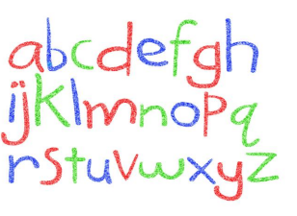
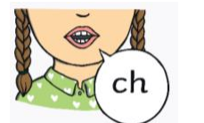
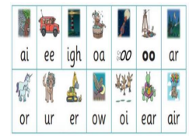
Did you know?
The English language has:-
26 letters
44 sounds
Over 100 different ways to spell

Slide 12

New DFE Guidance for Early Reading and Phonics The journey to independent reading and writing begins with
littlewandlelettersandsounds.org.uk
Why Little Wandle? Excellent training for all staff to ensure consistency. Every aspect of phonics and reading included in a detailed, thorough and systematic approach. Engaging resources without distracting from the learning. Comprehensive system for identifying and supporting children requiring extra help Useful support for parents.

Slide 13
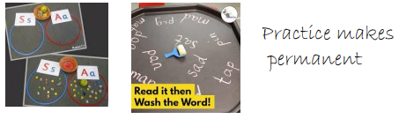
How we teach phonics
Daily short sessions
Currently in Y1 & 2 catch up sessions are taught to address children who gaps in their phonic knowledge
Synthetic phonics Specific order of teaching
Repeated practice - Revisit previously taught sounds at start of each lesson
m-u-s-t
Practice makes permanent Correct pronunciation - is vital - Videos on LW
https://www.littlewandlelettersandsounds.org.uk/resources/for-parents

Slide 14
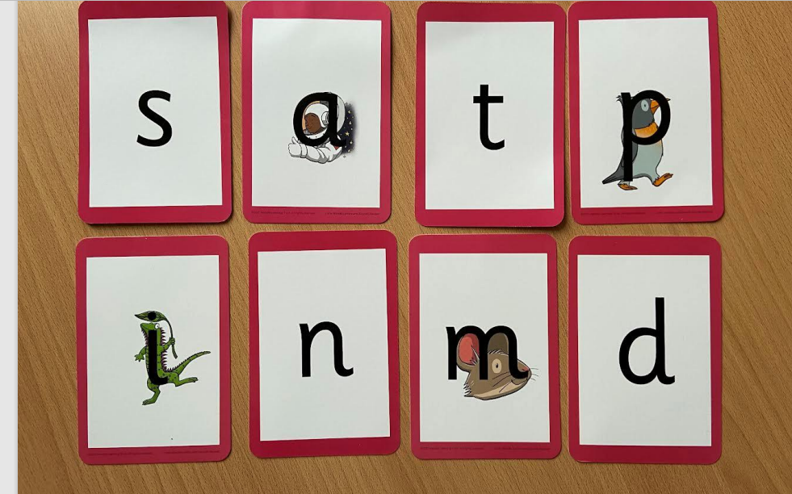

Slide 15
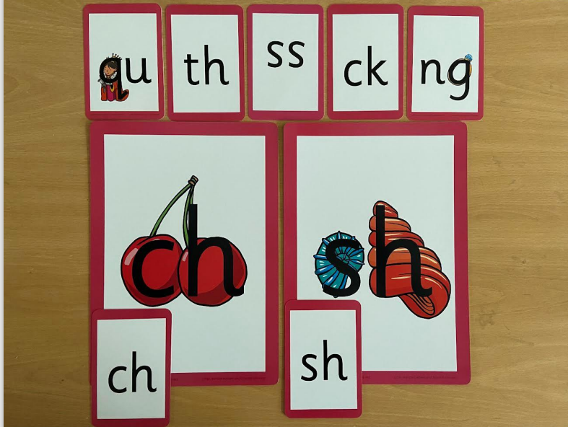

Slide 16
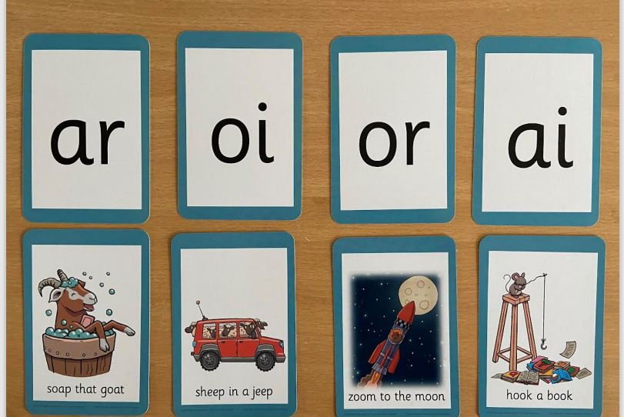

Slide 17
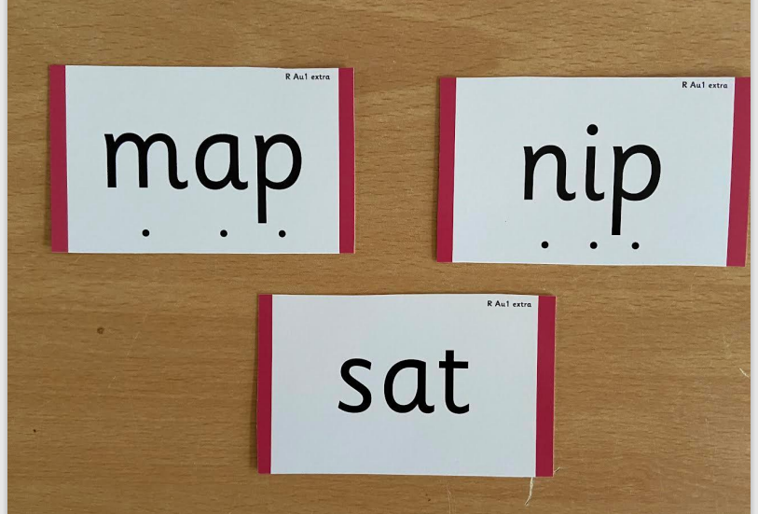

Slide 18
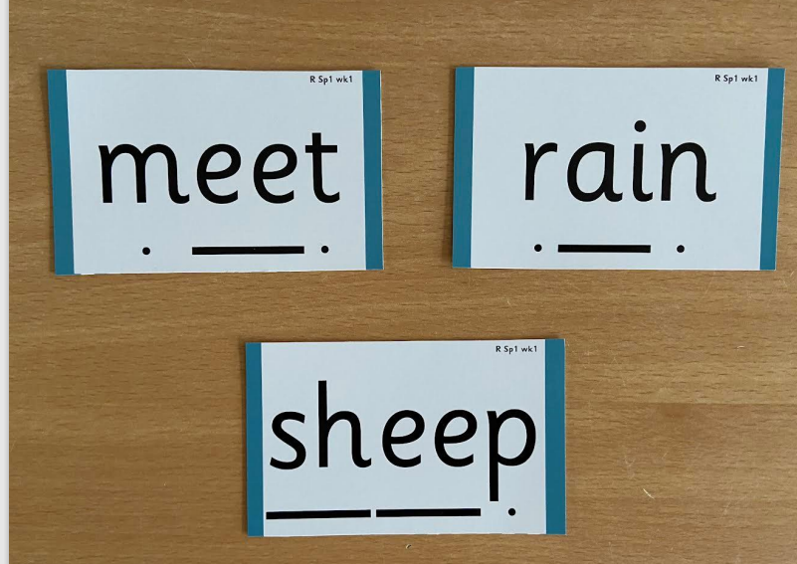

Slide 19
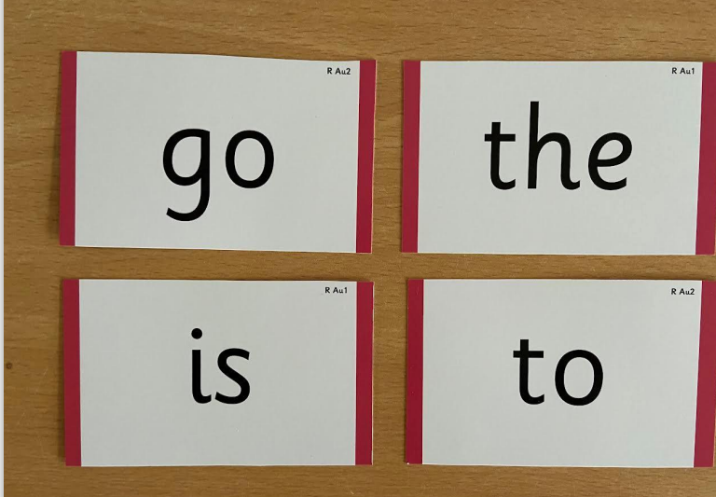

Slide 20
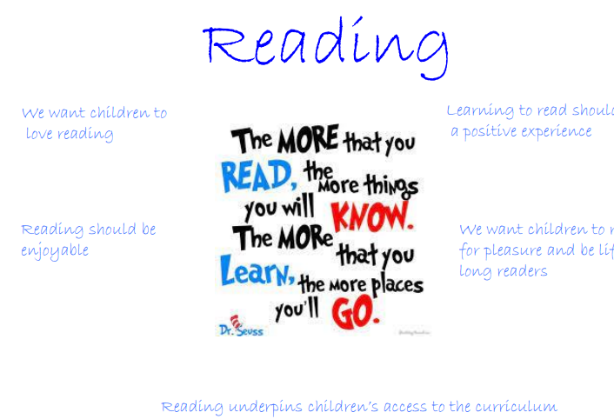

Slide 21
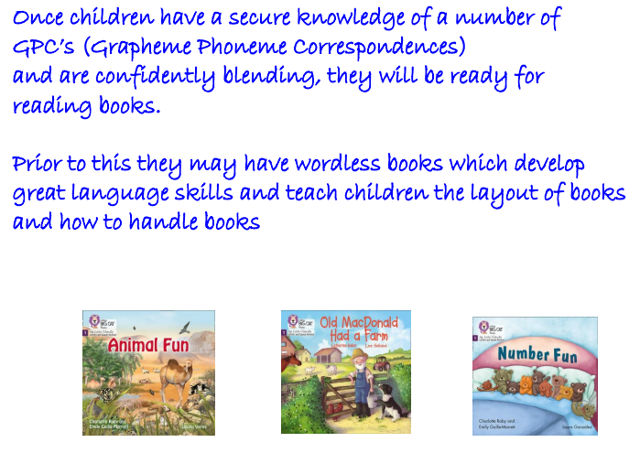

Slide 22
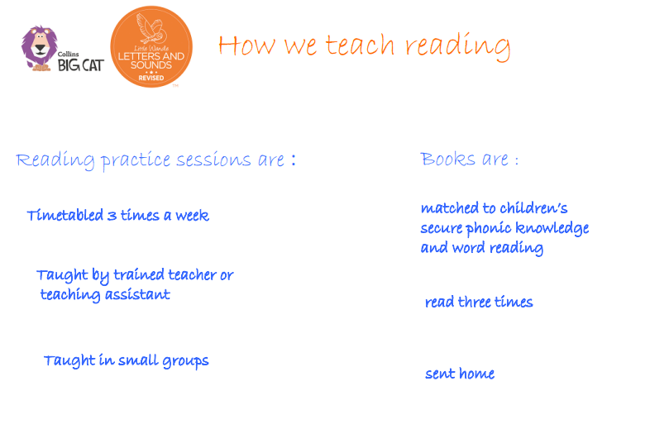

Slide 23
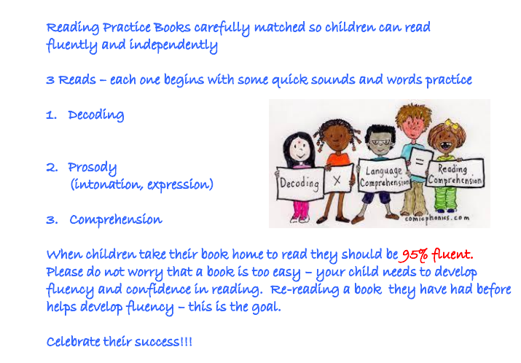

Slide 24
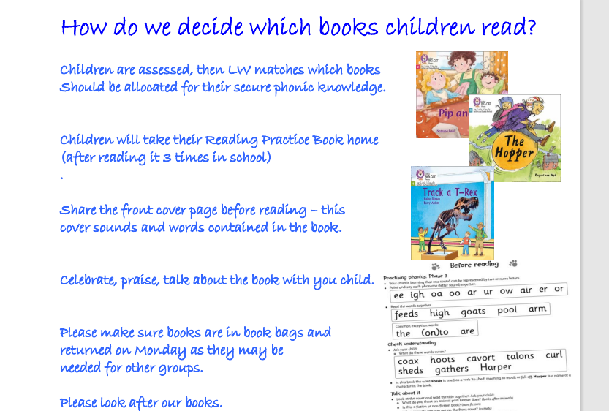

Slide 25
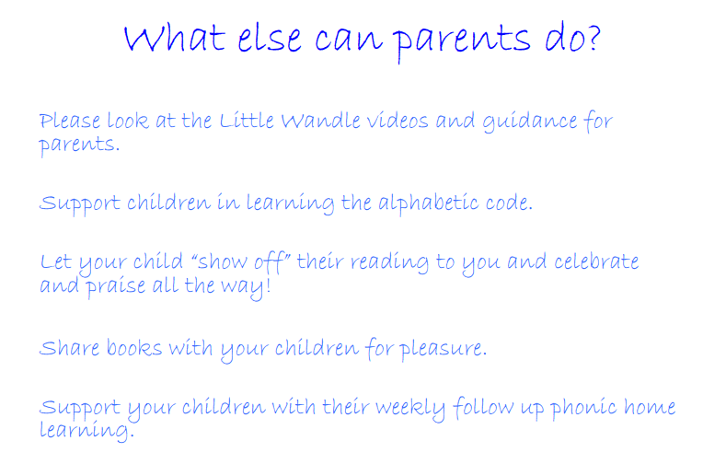
https://www.st-johns-gosport.hants.sch.uk/page/?title=Phonics&pid=27
We are going to update our website with useful links and tips for reading at home.
We are going to send home a monthly reading newsletter.

Slide 27

Any questions…..

