Slide 1
KS1 Assembly
Mrs Wilkinson - Headteacher
Autumn Term - Week 1
The Six Strands
Boundaries, Resilience, Focus, Respect,
Self Regulation, Independence
Our School Values
Love, Courage and Respect

Slide 2
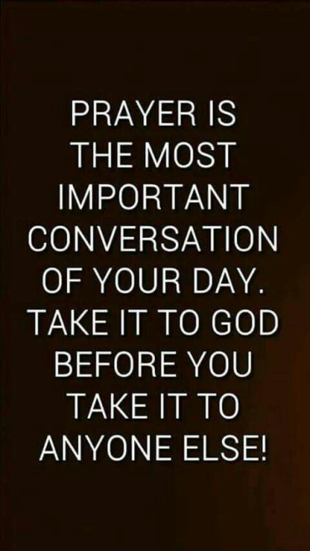
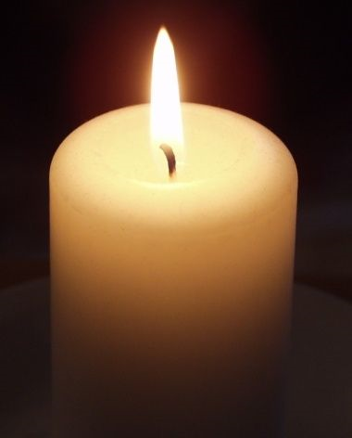
Candle Prayer
Dear Lord Jesus
We light this candle to remind us
That you are the light of the world.
As we come together now
To pray and to praise
May we remove all darkness
From our hearts and minds.
Amen

Slide 3
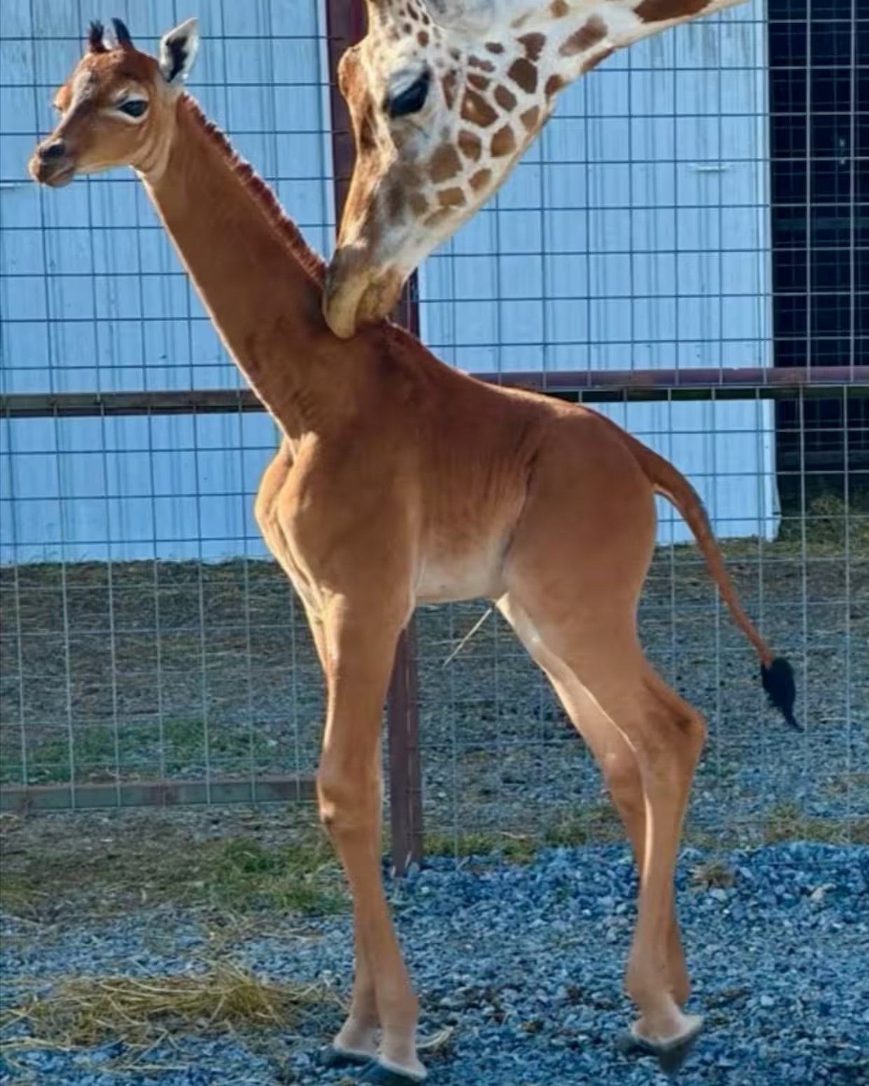
n
A baby giraffe was born in Tennessee, America, during the summer.

Slide 4
https://www.theguardian.com/world/2023/aug/21/spotless-giraffe-tennessee-zoo?fbclid=IwAR3Dif8lkIEQmMqZVQdtZdRhxaLEDe_QJjh0OrX5LmFFu3_mIZ3mLlcjfJ4

Slide 5
Name Competition
Current favourites are:
Kipekee, which means "unique" in Swahili;
Firayali, which means "unusual";
Shakiri, which means "she is most beautiful" and
Jamella which means "One of great beauty”
Which name do you like best?

Slide 6
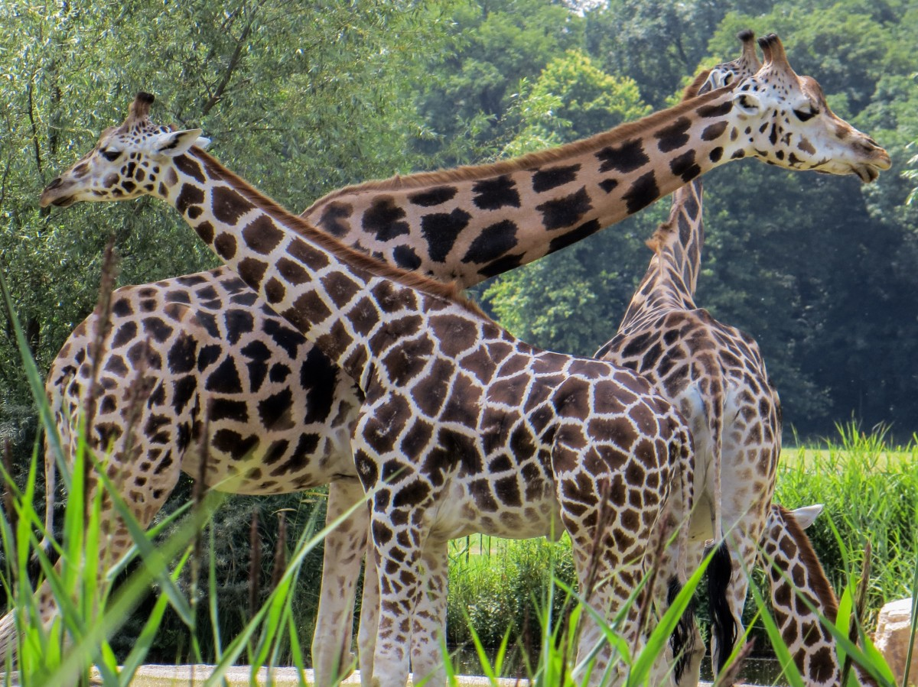
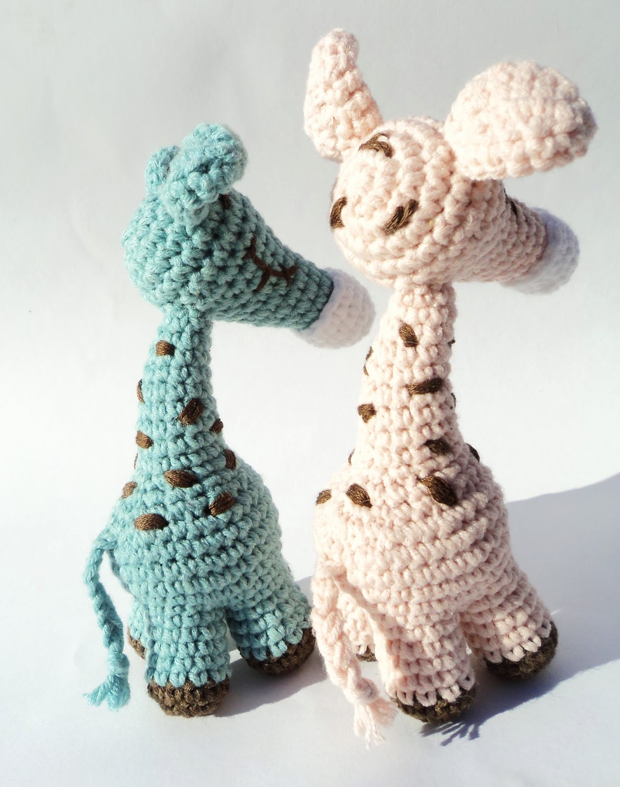
Some things to think about!
What is a giraffe and what do they normally look like?
Can this be a proper giraffe if it has no patches?
But don't all giraffes have to look the same? you can't have pink lions or blue penguins. and after all, all humans look the same don't we, so giraffes should also look the same. It can't be a proper giraffe!
This Photo by Unknown Author is licensed under CC BY-NC-ND

Slide 7
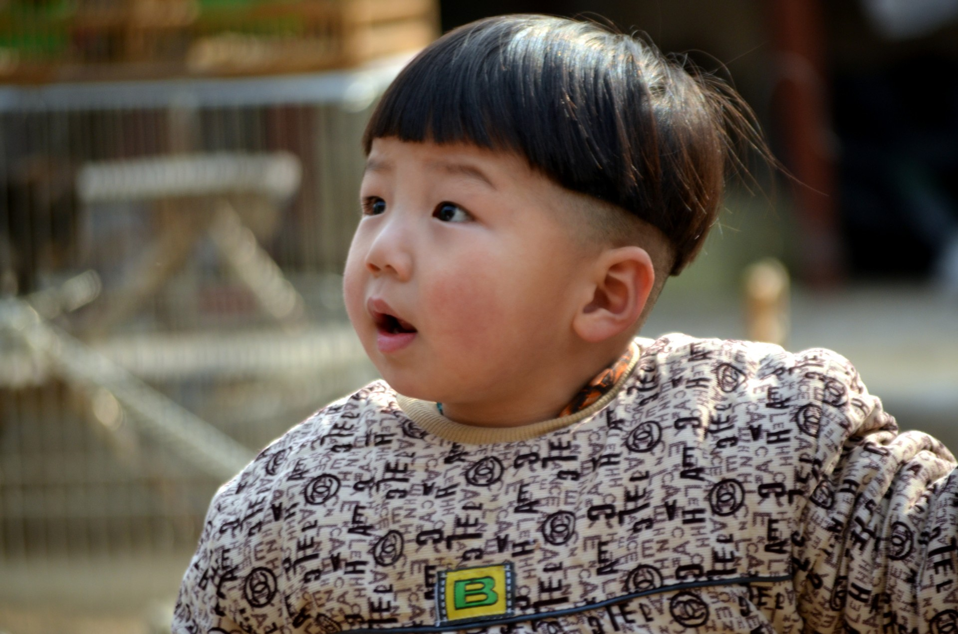
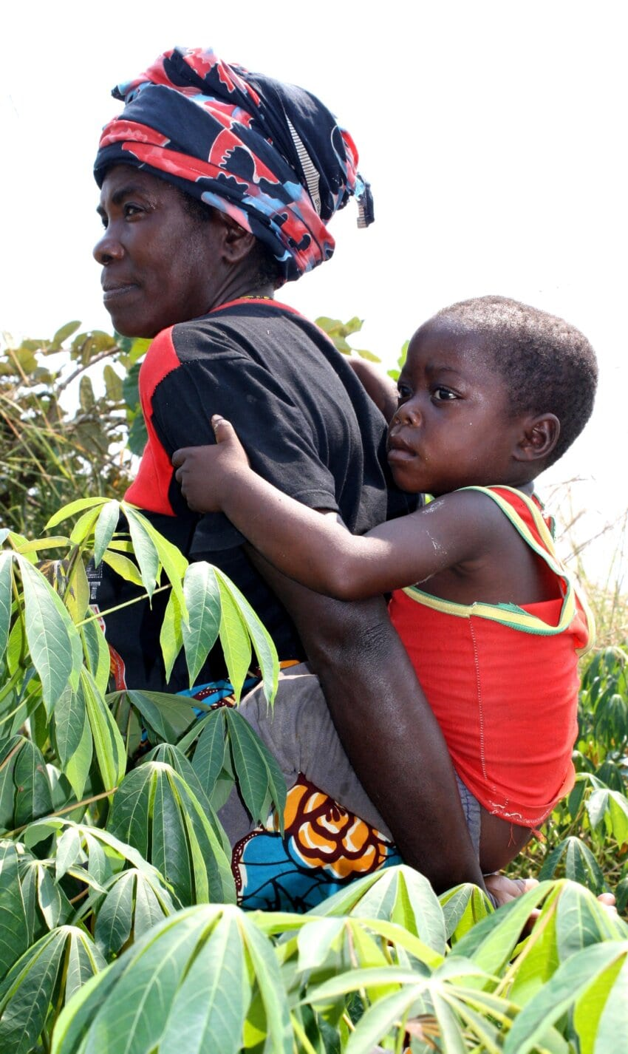
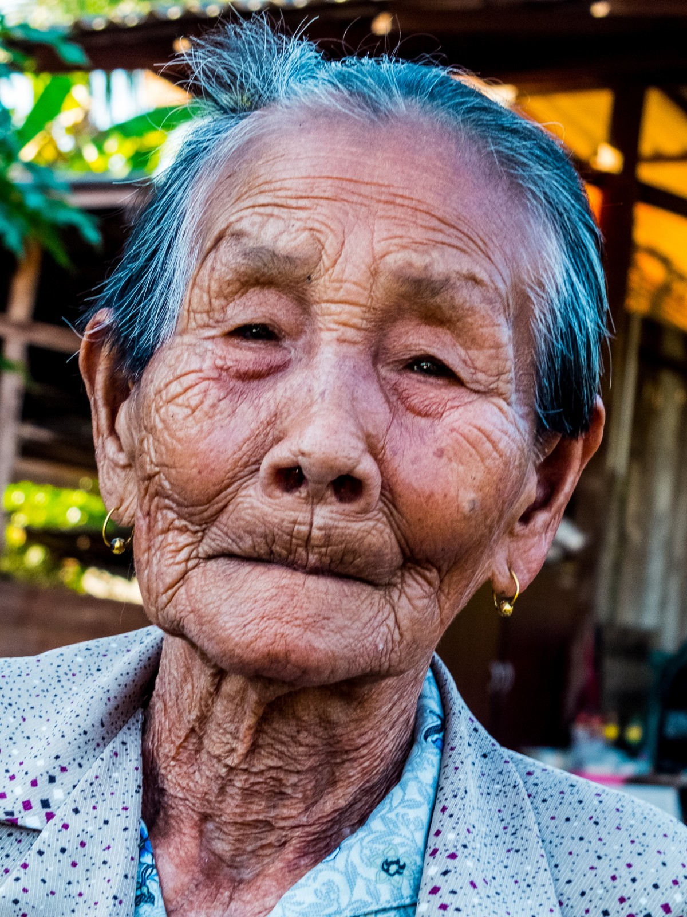
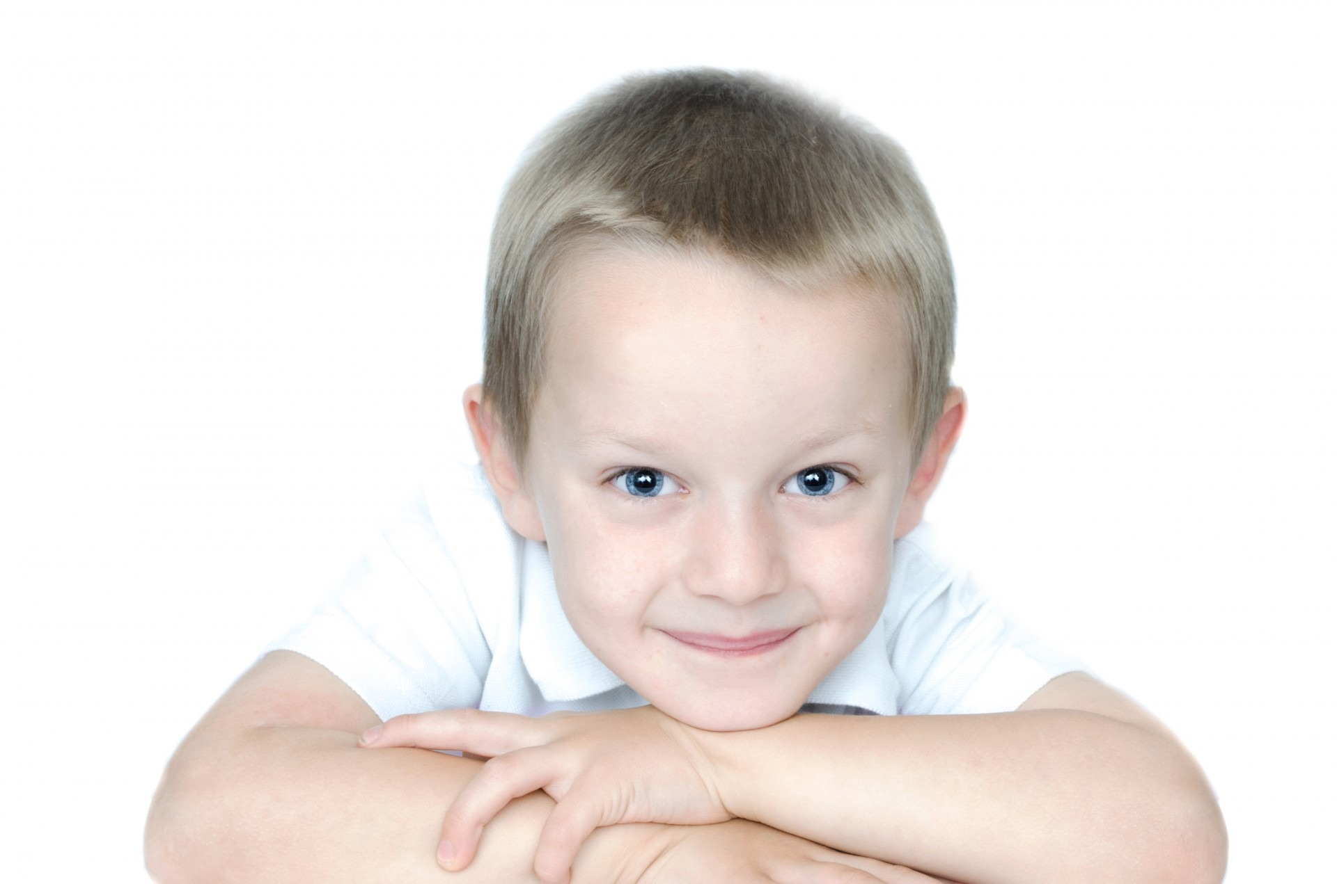
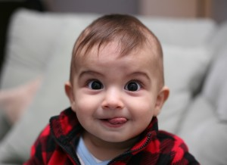
After all, all humans look the same … don't we?
This Photo by Unknown Author is licensed under CC BY-NC-ND
This Photo by Unknown Author is licensed under CC BY

Slide 8
So should giraffes all look the same?
What do you think?

Slide 9
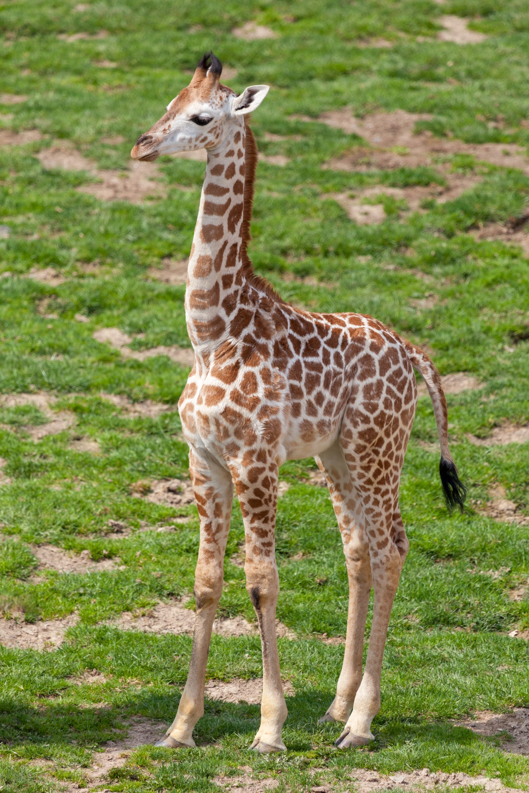
I wonder if the baby giraffe mum is proud of her baby, or do you think mum wishes the baby looked like the other giraffes?

Slide 10
Do all children have to look the same as their mums or the family?
This Photo by Unknown Author is licensed under CC BY-SA

Slide 11
If, when the giraffe was older, they said to you they wished they had patterns like the other giraffes, what would you say?
I would say ….

Slide 12
What do we say in our school about difference?

Slide 13
What can we learn from this baby giraffe?

Slide 14
Why do you think this is about No Outsiders?

Slide 16
It’s OK to be different!
Let’s think quietly about that for a moment.
It’s OK to be different.
It’s OK to look different.
It’s OK to sound different.
It’s OK to be good at different things.
It’s OK to like different things.
It’s OK to eat different foods.
It’s OK to support different teams.

Slide 17
Father God, we thank you that we are all different. Life would be so boring if we were all the same. Help us to embrace difference. Help us to celebrate difference. Help me to be a good friend. Let us always remember that it’s OK to be different.
Amen.

Slide 18
p.s. Which is our favourite name?
Kipekee, which means "unique" in Swahili;
Firayali, which means "unusual";
Shakiri, which means "she is most beautiful" and
Jamella which means "One of great beauty”
Let’s vote!!

Slide 19
Our School Prayer
Father God, protect us,
Keep us safe at school each day.
Jesus Christ, be with us
in our work and in our play.
Holy Spirit, guide us,
Keep our hope and vision high.
Give us faith, fun and friendship
As we learn, love and fly.

