Slide 1
No Outsiders-KS1
Mrs Wilkinson - Headteacher
Autumn 1 - Week 1
The Six Strands
Boundaries, Resilience, Focus, Respect,
Self Regulation, Independence
Our School Values
Love, Courage and Respect

Slide 2
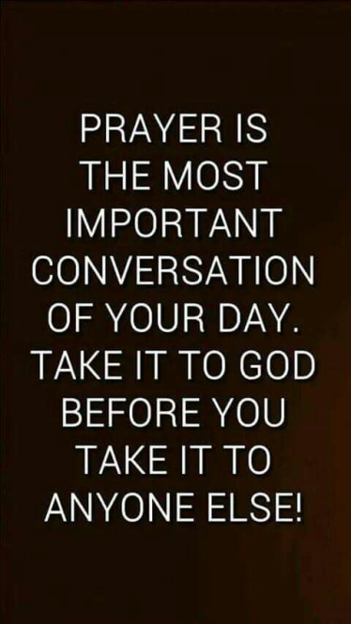
Candle Prayer
Dear Lord Jesus
We light this candle to remind us
That you are the light of the world.
As we come together now
To pray and to praise
May we remove all darkness
From our hearts and minds.
Amen

Slide 3
Equalities Act 2010 aims to protect people from discrimination.

Slide 5
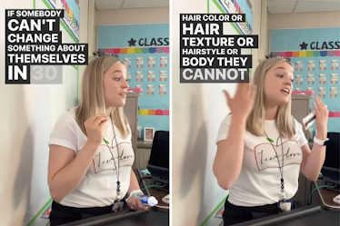
Who do you think the person is in the picture? Where is she? What is she doing?

Slide 6
Natalie Ringold is a teacher who has become famous after delivering a simple message to her class.
Parts of the message are on the picture above, but some words are missing. Can you work out what the message is?

Slide 7
The message is …
"Something you can't change in 30 seconds.“
What do you think this message is about?

Slide 8
Let’s watch the video…..
https://www.upworthy.com/teachers-rule-about-something-you-cant-change-in-30-seconds-is-a-lesson-for-all-ages
In the video Natalie says " "If someone can't change something about themselves in 30 seconds or less, then you shouldn't be mentioning it to them."
- what does Natalie mean? Can you think of things a person can change about themselves in 30 seconds? (shoes untied, fly on someone's jumper..)
- what can a person not change about themselves in 30 seconds? (hair colour, hair style, skin colour, family, body working differently
She also squeezes a tube of toothpaste to illustrate her message -
why do you think she does that? What is she trying to show with the toothpaste?
Natalie says, "Your words have power. your words matter. If you walk out of this room spreading kindness to the people around you, spreading love to the people around you, that is what truly makes a difference." -
- what does that mean?
- how can we spread kindness in our school?

Slide 9
-"Your words have power" what does this mean?
as she talks, Natalie squeezes a tube of toothpaste and then tries to get the paste back in the tube. It becomes messy and you can't put it back. What is she trying to show here?
- "You try to apologise, you try to take the words back, and you try to undo what you said, undo what you did. But it's something they couldn't change about themselves and do it gets very messy. You can't totally take those words back, you can't totally fix it."- do you agree? Can you give an example?
- Natalie says she wants her students to remember this for the rest of their lives - why? Do you think they will?
- How do we talk to people and make people feel at our school?
- Why is this about no outsiders?
- Which British value is this about?
- what can we learn from Natalie?

Slide 10
Why is this about No Outsiders?
Which of the protected characteristic is it about?

Slide 11
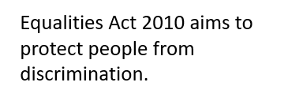
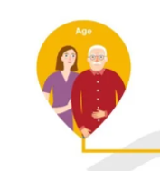
Every individual is equal regardless of what they look like, where they come from and who they are.
Do not treat people unfairly because they are not the same as you.
What does the bible tell us about respecting each other?
The Bible tells us to treat other people like we want to be treated. So if you are kind and say nice things to people, they will do the same to you.
MATTHEW Chapter 7 Verse 12
Do to others what you would have them do to you

Slide 12
Do you treat all people fairly regardless of what they look like, what they do, what they do or don’t have?

Slide 13
Our School Prayer
Father God, protect us,
Keep us safe at school each day.
Jesus Christ, be with us
in our work and in our play.
Holy Spirit, guide us,
Keep our hope and vision high.
Give us faith, fun and friendship
As we learn, love and fly. Amen

