Slide 1

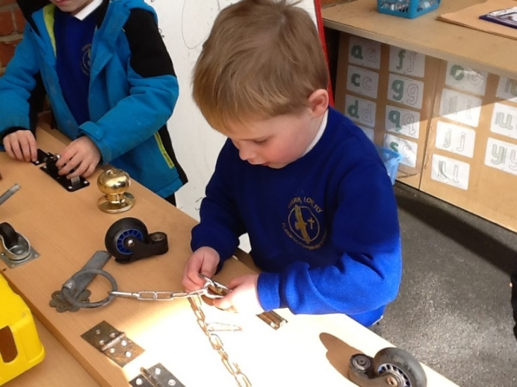
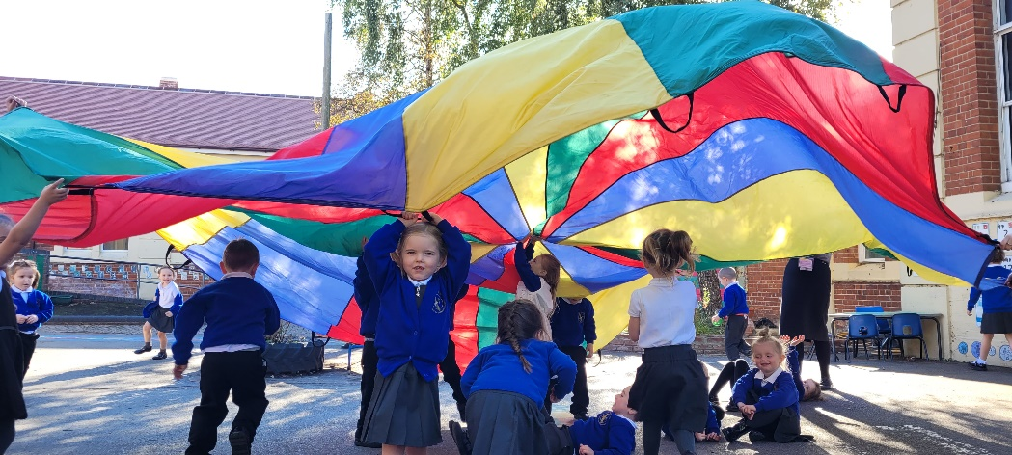
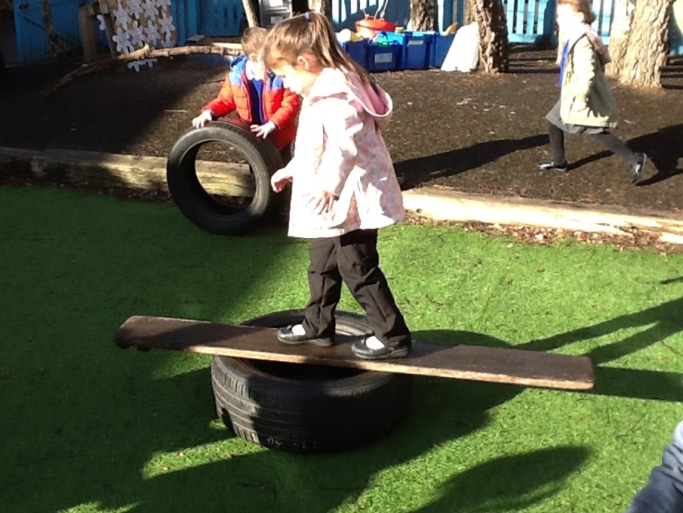
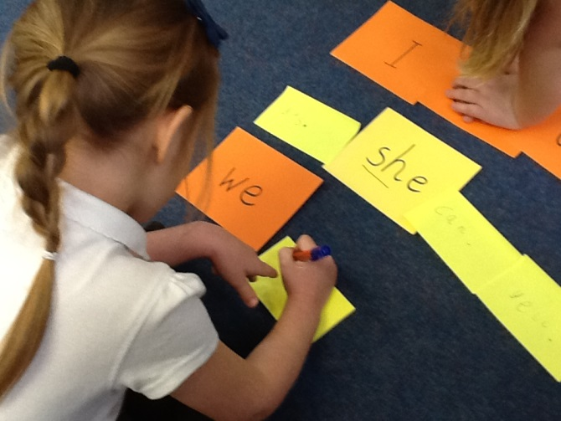
Hello and Welcome!
New Entrants 2023

Slide 2
Who’s Who?
Mrs Wilkinson - Head Teacher Mrs Havey- Deputy Head teacher
Mrs Jean Watson – Chair of Governors
Mrs Dickinson – EYFS Leader and RFD Class Teacher
Miss Hiseman - RKH Class Teacher
Mrs Newton - Early Years Teaching Assistant
Mrs Taylor - Early Years Teaching Assistant
Mrs Chambers – SENCo Mrs Rose – Behaviour Support
Mrs Blanksby – Family Support Worker and ELSA
Mrs Roberts – Speech and Language

Slide 3

Head Teacher’s Welcome

Slide 4
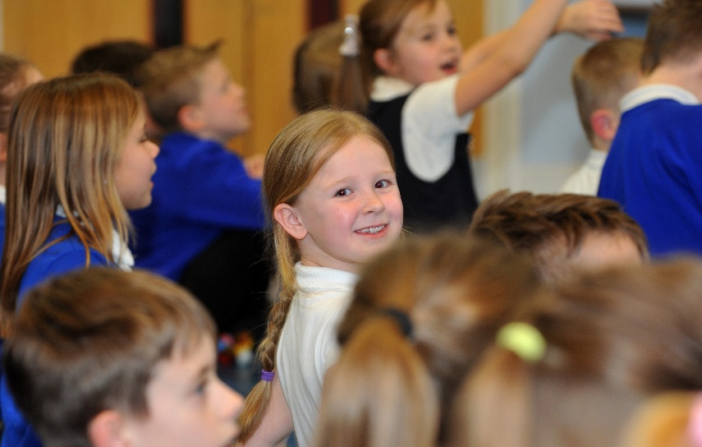
Attendance matters
There are 39 school weeks in the year = 195 days minus INSET days = 190 days teaching and learning during the school year.
There are 13 weeks school holidays in the school year = 91 days when children are on holiday
You should not take your child on school holiday during the term time.
REMEMBER: ABSENCE = LOST OPPORTUNITY!
If your child’s attendance during the school year is ... | Your child would have lost approximately …. | Or they would have missed approximately …..
95% | 9 days | 50 lessons
90% | 19 days | 100 lessons
85% | 29 days | 150 lessons
80% | 38 days | 200 lessons
75% | 48 days | 250 lessons
70% | 57 days | 290 lessons
65% | 67 days | 340 lessons

Slide 5
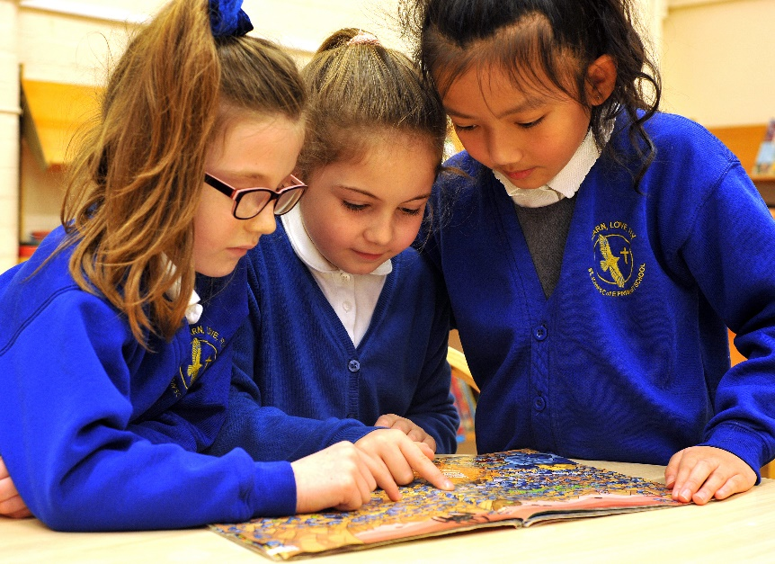
Year 6 Children
After the Early Years curriculum (Year R) children enter the National Curriculum in Year 1 to Year 6.

Slide 6
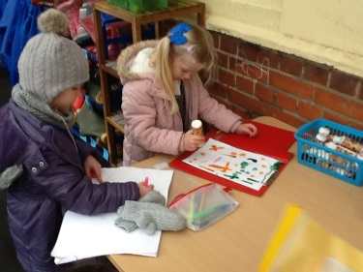
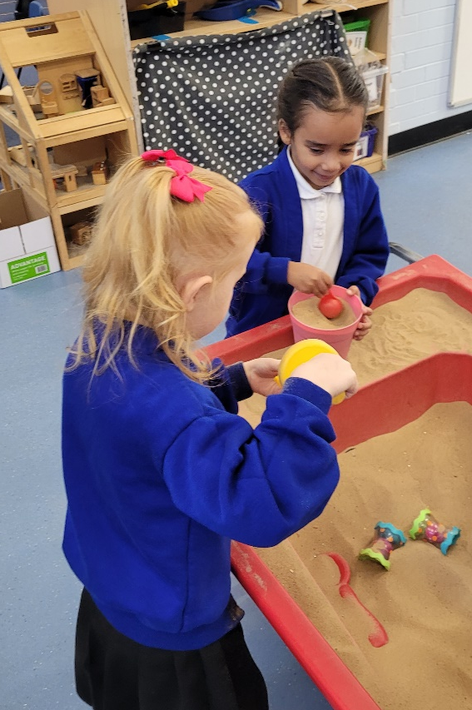
Year R Provision
At St John’s C of E Primary School we aim to deliver a rich, exciting and child led early Years curriculum that suits the needs of the children.
This is achieved by;
Providing a smooth transition into Year R
Following the interests of the children
Providing an exciting and stimulating environment

Slide 7
Transition 2023
Stay and Play sessions in school with the current Year R children on: Mon 12th, Tues 13th, Wed 14th, Thur 15th or Fri 16th June 2023.
These sessions will run from 10 – 11am and 1.15 – 2.15pm and need to be booked in with us before you leave.
Chat and Chill – get to know your fellow parents and their children in our library on: Tuesday 16th and 23rd May between 8:30 – 10am and Thursday 18th and 25th May between 3 – 6pm.
Home and Pre-school visits – these will take place in June.
Classes decided – June/July

Slide 8
Transition 2023
Nursery Rhyme Project Transition Days which will be on Tuesday 11th and Wednesday 12th July.
Home Visits - Your personalised invite for the Home Visits will be in the gift bag. Home visits 5th or 6th September 2023
Half Day Visits - The half day visits will be in classes. Children only.
- RFD Thursday 7th September am
- RKH Thursday 7th September pm
Family Teddy Bears’ Picnic – This will take place on Friday 8th September from 11:00-11:45. Parents and family members welcome.
All children to start full time from Monday 11th September 2023
All these elements help to provide a smooth transition from pre-school to school.
Teaching staff begin to build a strong and positive relationship with each child ready to support them and start their learning journey at St John’s school.

Slide 9
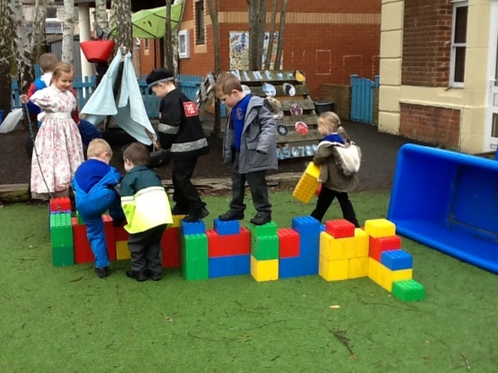
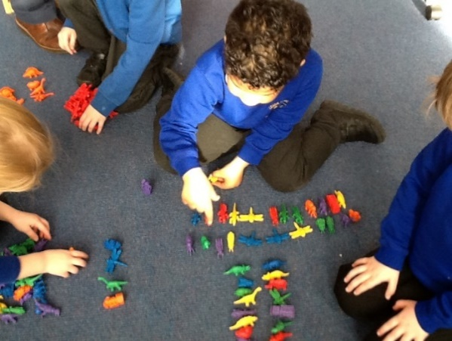
Typical day in Year R
Doors open with staff greeting the children
Register, lunches and date
Phonics input and reading
Exploring time begins
Rolling Snack time
Lunch
Maths input and activity
Exploring time
Tidy up time
Collective worship (assembly)
End of day

Slide 10

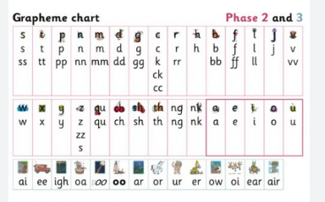


Phonics
How we will teach your child to read.
Children will start with wordless books and move through the different phases as the year goes on.
Your child would have read the book they bring home three times already. They should be fluent with the text.
Remember to celebrate their success.

Slide 11
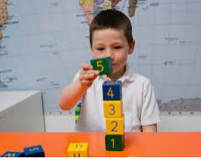
Reception Baseline Assessment
This is a statutory assessment for all reception age children in the country.
It covers literacy, communication and language, and maths.
Its short, practical tasks carried out by your child’s class teacher in the first week weeks of school.
It is used to measure progress throughout your child’s learning journey in primary school.

Slide 12

PE
Your child will be put in a colour team. If they already have a sibling at school they will be the same colour team.
PE will start after Christmas.

Slide 13

Tapestry
These are a record of your child’s learning journey through their reception year.

Slide 14
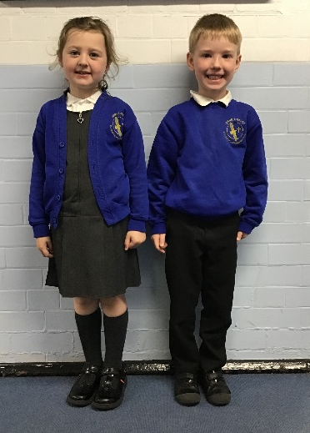
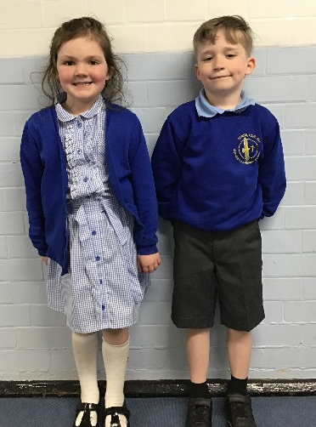
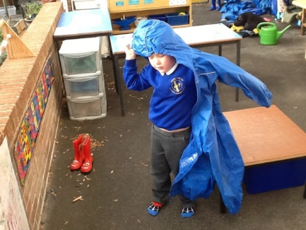
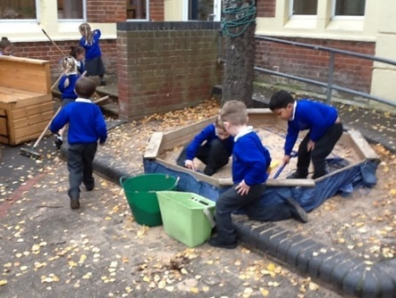
Other information
School dinners - Allergies
Uniform
Getting messy!
Book bags – they’re free!
Water bottles
Everything is to be named

Slide 15
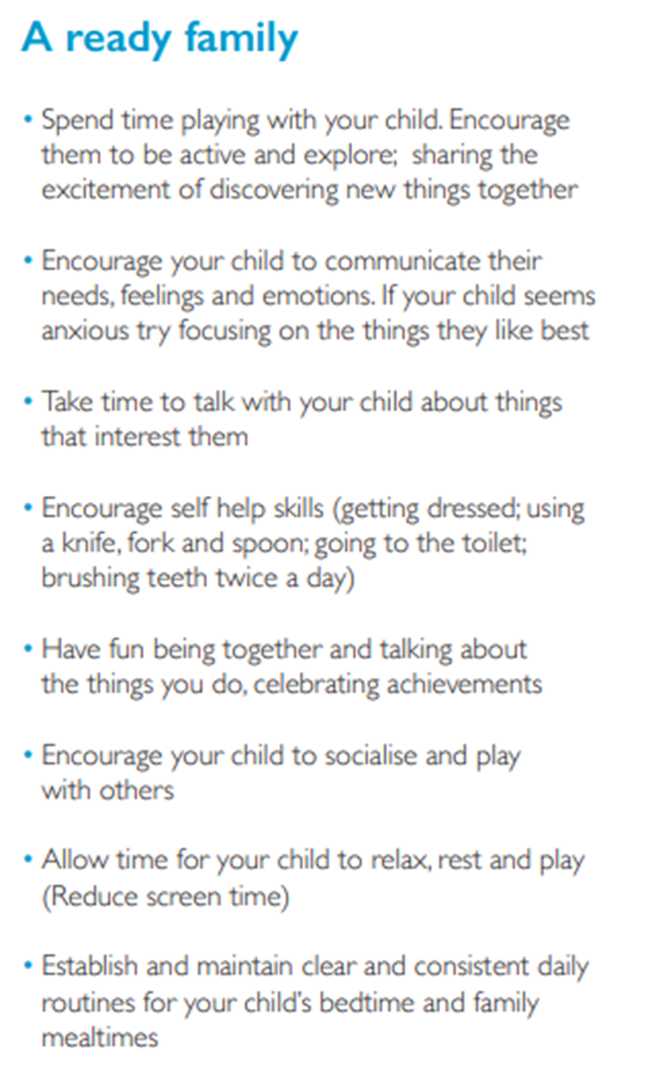
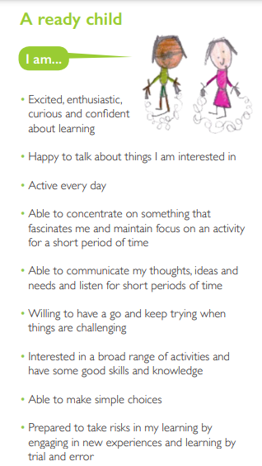
What can I do to help my child be ready for school?

Slide 16
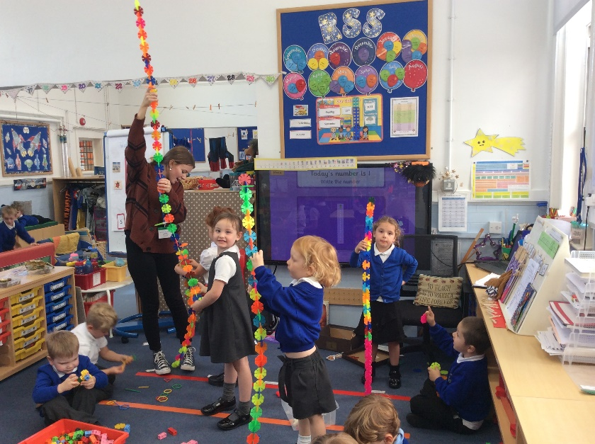
Final Thoughts
Please sign up for stay and play before you leave at a convenient time to you.
Transition dates 11th and 12th of July

