Slide 1
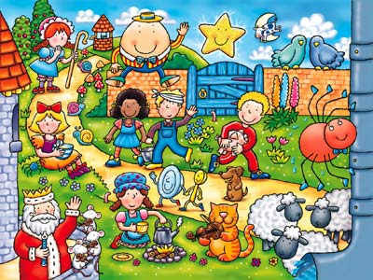
Welcome to our
Nursery Rhyme Project
Transition Day

Slide 2
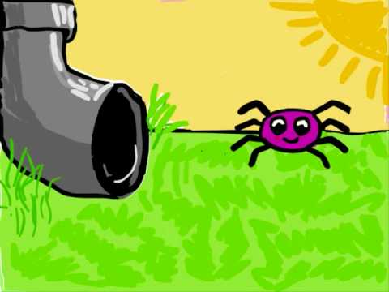
Incy Wincy Spider
Incy Wincy Spider climbed up the water spout,
Down came the rain and washed pour Incy out,
Out came the sunshine and dried up all the rain,
So Incy Wincy Spider climbed up the spout
again.

Slide 3

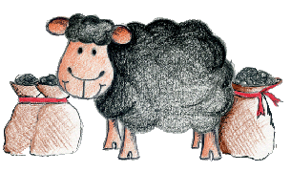
Baa Baa Black Sheep
Baa Baa Black Sheep
Have you any wool?
Yes sir, yes sir, three bags full.
One for the master and one for the dame,
And one for the little boy who lives down the lane.

Slide 4

Wind the Bobbin up
Wind the bobbin up, Wind the bobbin up,
Pull, pull, clap, clap, clap
Wind it back again, Wind it back again,
Pull, pull, clap, clap, clap
Point to the ceiling, point to the floor,
Point to the window, point to the door.

Slide 5
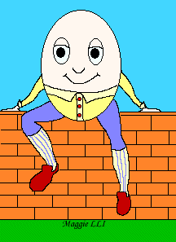
Humpty Dumpty
Humpty Dumpty sat on the wall,
Humpty Dumpty had a great fall,
All the king’s horses and all the king’s men
Couldn’t put Humpty together again.

Slide 6

Hey Diddle Diddle
Hey, diddle, diddle,
The cat and the fiddle,
The cow jumped over the moon.
The little dog laughed
To see such fun,
And the dish ran away with the spoon.

Slide 7

For parents | Letters and Sounds (littlewandlelettersandsounds.org.uk)

Slide 8

Explore time
Now it’s time to play in our unit. There are lots of nursery rhyme activities to do and take home.
Tea party (Polly put the kettle on)
Dice game (hickory dickory dock)
Baa baa white sheep
Play dough
Magnetic game (1,2,3,4,5 once I caught a fish alive)
Make a spider (Incy Wincy)
Baby clinic (Jack and Jill)

Slide 9
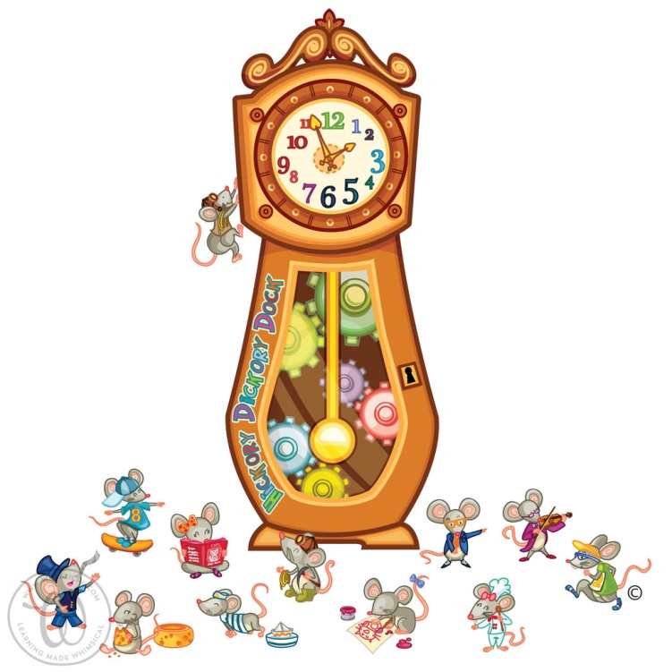
Hickory Dickory Dock
Hickory, dickory, dock,
The mouse ran up the clock.
The clock struck one,
The mouse ran down,
Hickory, dickory, dock.

Slide 10


1, 2, 3, 4, 5
1, 2, 3, 4, 5 once I caught a fish alive,
6, 7, 8, 9, 10 then I let it go again,
Why did you let it go?
Because it bit my finger so,
Which finger did it bite?
This little finger on my right.

Slide 11
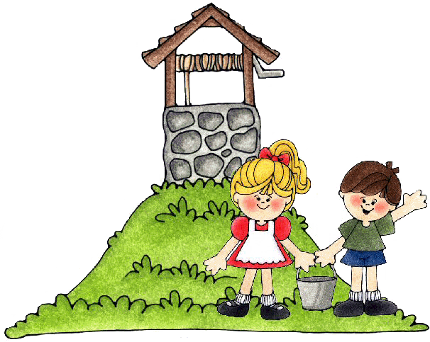
Jack and Jill
Jack and Jill
Went up the hill
To fetch a pail of water.
Jack fell down
And broke his crown
And Jill came tumbling after.

Slide 12
Twinkle Twinkle
Twinkle, twinkle, little star,
How I wonder what you are.
Up above the world so high,
Like a diamond in the sky.
Twinkle, twinkle, little star,
How I wonder what you are.

Slide 13

Thank you for coming today…
In your book bag:
Home visit day and time 3rd,4th and 5th September
Colour balloon - please put on your door the day we visit!
Half day visit 6th September 9.30am-11am
Teddy Bear’s Picnic Friday 13th September at 12pm-1.30pm. You can take your child home after.

Slide 14

Thank you for coming today…
A few things for September…
School uniform
PE Kits (No need until January)
Wellies
Warm, waterproof coats
All children full time from Monday 9th September at 8.30am

