Slide 1
Year 1 2023
1SS
Mrs Schneider
with
Mrs Matthews
Mrs Kodroska
1MS
Mrs Stock
with
Miss Smith
Miss Grist
Arrive: 8:30am Finish: 3:00pm
Please go to office if you are late

Slide 2
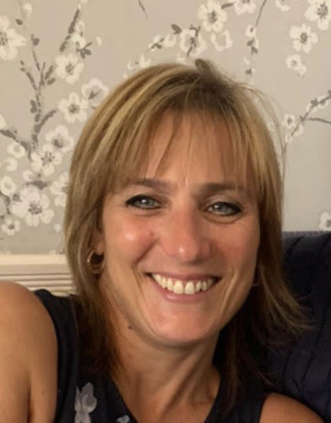
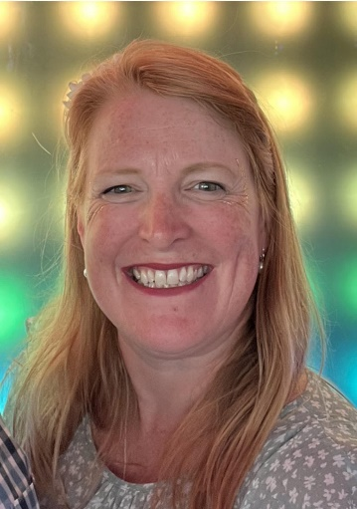
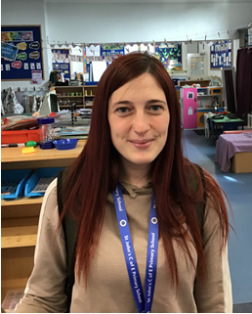
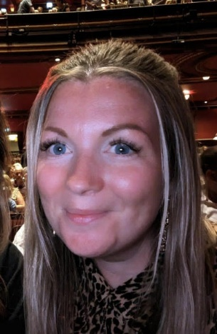
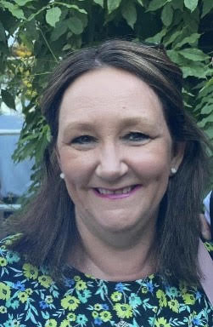
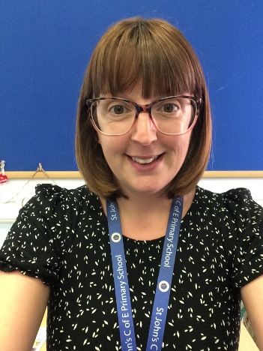
Meet The Team
If you are in 1MS, your teacher is Mrs Stock.
If you are in 1SS, your teacher is Mrs Schneider
Hayley Campbell will be covering Leadership time and PPA across the classes
Our Learning Support Assistants, although they are attached to one class, work across Year 1 so you may get to work with any of them.
Year 1 LSAs are: Miss Grist, Miss Smith, Mrs K and Mrs Matthews

Slide 3
Our Curriculum
We cover a broad and balanced curriculum with a large focus on building phonics skills for reading and writing.
It is therefore essential that children attend school every day.
English – reading, writing, phonics, handwriting
Maths – number, shape, space and measure
Science – Living things, forces, materials
Geography – where we live, weather, Shang Hai
History – Toys, Titanic, Explorers
Computing – online Safety, using a computer
Music – singing and playing, rhythm, dynamics,
PE – dance, gymnastics, games, ball skills
Art – paint, pastel, drawing, collage, artists
DT – Fruit smoothies, Moon buggies
RE – Christianity and Sikhism
Jigsaw (PSHE) – healthy me, celebrating difference
Please read the newsletters and the year group half termly newsletters for more information.

Slide 4
Writing
Year One Core Writing skills
- write all the lower case letters of the alphabet correctly.
- sequence sentences to form short narratives.
- read what I have written to check it makes sense.
- name the letters of the alphabet in order.
- write from memory simple sentences dictated by the teacher including GPCs.
- start to use capital letters, full stops, question marks and exclamation marks.
- sit and hold my pencil correctly.
- form capital letters correctly.
- form digits 0-9 correctly.
- compose a sentence orally before writing.
- read my writing aloud audibly and clearly.
- use suffixes -ing, -ed, -er and –est.
- leave spaces between words.
- join words and clauses using 'and'.
Sounds and key words can be found in reading diaries

Slide 5
Reading
Year One Core Reading Skills
- read more than 40 sounds.
- easily read the first 100 common words.
- read accurately by blending known GPCS.
- read common exception words.
- read common suffixes.
- read accurately by blending sounds in unfamiliar words.
- read aloud and understand books appropriate to my phonic knowledge.
- listen to and discuss a wide range of poems, stories and non-fiction.
- become familiar with key stories, fairy stories and traditional tales.
- recite some poetry by heart.
- check that the text makes sense as I read.
- self-correct while reading.
- discuss the significance of title and events.
- make predictions based on what I have read so far.
- understand what is read to me.
Sounds and key words can be found in reading diaries

Slide 6
Maths
Year One Core Maths Skills
- count to and across 100, forwards and backwards, beginning with 0.
- count to and across 100, forwards and backwards from any given number.
- read and write numbers to 100 in numerals.
- count in multiples of twos, fives and tens.
- say one more and one less than any number to 100.
- know my number bonds and subtraction facts to 20.
- understand half as one of two equal parts of an object, shape or quantity
- compare, describe and solve practical problems for:
1. lengths and heights eg long/short, longer/shorter, tall/short, double/half;
2. mass/weight eg heavy/light, heavier than, lighter than;
3. capacity and volume eg full/empty, more than, less than, half, half full, quarter;
4. Time eg quicker, slower, earlier, later.
- tell the time to the hour and half past the hour and I can draw the hands on a clock face to show these times.
- recognise and name common 2-D and 3-D shapes, including:
* 2-D shapes eg rectangles (including squares), circles and triangles;
* 3-D shapes eg cuboids (including cubes), pyramids and spheres.

Slide 7
Little Wandle
As many of you know from last year, we are using the Little Wandle Phonic Scheme.
These are daily phonic lessons which work alongside the daily guided reading sessions.
There will be a parent work shop coming soon to explain this in more detail.
The Little Wandle books will be
sent home on a Thursday and
MUST be returned on a Monday

Slide 8
Phonics Check
Taking place in June, date to be confirmed.
Read a mix of 40 real and alien words containing the sounds (phonemes) taught.
Children will be well prepared in school and activities will be sent home.
Focussed groups will take place in school to address gaps.
Phonics play is a really useful website for practising real and alien words (Obb and Bob game) - https://www.phonicsplay.co.uk/
Reading with your child is essential for their success.

Slide 9
Examples of real and alien words

Slide 10
Reading at home
We expect children to be reading at least 5 times a week.
Reading diaries have already been sent home to record their daily reading and work towards certificates.
Please also share stories and the Love To Read Books with your children and encourage to ask and answer questions as this supports with language and vocabulary.

Slide 11
At St John’s we teach British values and equality through our personal development lessons.

Slide 12
Two of the ways we teach about equality is through the use of books and also a half-termly collective worship where we focus on something from the media that highlights inequality and ‘ No Outsiders’ .

Slide 14
Other Information
Water bottles - bring your own NAMED with water.
School uniform- please ensure this is NAMED.
PE kits - coloured shirt and PE bottoms to be worn to school EVERY Monday and THURSDAY. Please ensure your child has shoes they can fasten INDEPENDENTLY please.
Library - Tuesday afternoon
Please check the school website for any other school updates.
Trips - Please see the newsletter for school trips. The first trip is payable by the 6th of October to SEARCH and the cost is £5.

Slide 15
Thank you for coming and we are looking forward to working with you this year.

